Slide 1


Which sign design elements drive consumer appeal?
A-FRAME SIGN STUDY Appeal Report | August 2026
Prepared by: J Brown Fitterman | jbrown@mindgenomicsassociates.com
Mind Genomics Associates, Inc
A-FRAME SIGN STUDY

Slide 2
Inputs

Slide 3
The study in this report
Scores in the pages that follow come from this file.
A-FRAME SIGN STUDY
5 silos · 62 elements
312 respondents
n=312 respondents. Top-2 Box model (ratings 4–5): element lifts show movement above or below the model baseline.
3

Slide 4
How the method works
Every respondent sees their own mix of design variations, and we learn what individually moves the appeal score.
01
We slice the design into unique elements
Each element is one design choice — Backgrounds, Headlines, Sub Headers, Images, and CTA.
02
Each element has 6–16 possible variations
Like the small choices a designer would make between the options in a silo.
03
Each respondent sees a set of pack designs
Each pack is a unique combination of variations — never quite the same as anyone else’s.
04
They rate each one
The same rating scale is used on every task. The variation does the work.
05
We learn what drives the rating
The model separates the baseline from the movement each element creates, on its own.
n=312 respondents. Top-2 Box model (ratings 4–5): element lifts show movement above or below the model baseline.
4

Slide 5
Design elements
5 design silos, 62 element variations in total.
A
Backgrounds
6
B
Headlines
16
C
Sub Headers
16
D
Images
8
Background Layer Cotton, +5
Headline Do You Know Where Your Food Comes From, +15
Sub Header 80 Sourced Within 70 Miles, +15
Image Layer Box Graphic, +7
E
CTA
16
Cta 80 Sourced Within 70 Miles, +15
Each card shows the silo letter, the element count, and a sample of the options.
n=312 respondents. Top-2 Box model (ratings 4–5): element lifts show movement above or below the model baseline.
5

Slide 6
WHAT YOU GET BACK
What design elements drive pack appeal?
01
02
Per-element scores
Base appeal
How much each variation moves the appeal rating, on its own, above or below the baseline.
The Top-2 Box intercept. The pack’s starting appeal before a single element is added.
03
04
Build-up scenarios
Full lift summary
The strongest element in each leading silo, added together, against a weaker combination of the same silos.
Every element, in every silo, with the same score used in the charts.
n=312 respondents. Top-2 Box model (ratings 4–5): element lifts show movement above or below the model baseline.
6

Slide 7
Reading The Scores – What The Coefficients Mean
1
Element Lift Scores
Element lifts show the estimated movement each design choice creates above or below the model baseline.
2
Explore Combinations
3
Reading The Scale
These scores can be combined to explore multiple design scenarios.
Coefficient Interpretation
Coefficient Scale | Interpretation
+10 or higher | Strong lift
+5 to +9.9 | Moderate lift
+2 to +4.9 | Small lift
Below +2 | Minimal / weak lift
n=312 respondents. Top-2 Box model (ratings 4–5): element lifts show movement above or below the model baseline.
7

Slide 8
Key Findings

Slide 9
KEY FINDINGS
Where appeal moves
The strongest movement comes from the silos and elements below. Detail charts for every silo follow.
01
The model has a clear starting point
Base appeal is 50%. That is the Top-2 Box baseline before any single design element adds or subtracts lift.
02
Headline Visit Our Booth For 50 Off is the strongest single cue
In Headlines, Headline Visit Our Booth For 50 Off moves appeal by +11. 38 of 62 elements sit above the baseline.
03
Headlines is the lead design area
Headline Visit Our Booth For 50 Off tops this silo at +11. Headlines has the widest spread, +11 points from Headline Prefer Big Grocery Chains Keep Walking to Headline Visit Our Booth For 50 Off.
04
Cta Skip The Grocery Store is the largest drag
In CTA, Cta Skip The Grocery Store sits at -4. Negative lifts pull the appeal score below the model baseline.
n=312 respondents. Top-2 Box model (ratings 4–5): element lifts show movement above or below the model baseline.
9

Slide 10
MODEL OVERVIEW: BASE APPEAL
Base appeal before element lift
Base appeal is this model’s starting Top-2 Box score (ratings 4–5) before individual design elements add or subtract lift.
BASE APPEAL
HOW TO USE IT
A-FRAME SIGN STUDY
Each element chart is movement around this number, not a new total by itself.
50%
A build-up adds the baseline and one lift from each silo. That sum is a model scenario. It is not capped at 0 or 100.
Model baseline · intercept
Base size 312
n=312 respondents. Top-2 Box model (ratings 4–5): element lifts show movement above or below the model baseline.
10

Slide 11
KEY FINDINGS
Appeal moves most clearly
in four design areas
These are the silos where one element, or the gap inside the silo, moves appeal the most.
ROADMAP FOR THE READ
01
02
03
04
Headlines
Images
Sub Headers
CTA
Headline Visit Our Booth For 50 Off leads at +11.
Low end is Headline Prefer Big Grocery Chains Keep Walking.
Image Layer Farm leads at +7.
Low end is Image Layer Delivery Graphic.
Sub Header Win A Free Month Of Groceries! leads at +6.
Sub Header Prefer Big Grocery Chains Keep Walking pulls the other way.
Cta Visit Our Booth For 50 Off leads at +3.
Cta Skip The Grocery Store pulls the other way.
The clearest appeal movement is concentrated in Headlines, Images, Sub Headers, and CTA.
n=312 respondents. Top-2 Box model (ratings 4–5): element lifts show movement above or below the model baseline.
11

Slide 12






KEY FINDINGS: BACKGROUNDS
Background Layer Cotton leads the backgrounds set
Every option is at or above the baseline. Background Layer Cotton is furthest ahead at +1.
Background Layer…
Background Layer…
BACKGROUNDS PREFERENCES
+1
+1
Background Layer
Cotton
+1
Background Layer
Cream
+1
Background Layer
Lemon
+1
Background Layer…
Background Layer…
+1
+1
Background Layer
Melon
+1
Background Layer Sky
+1
Background Layer
Mint
0
Background Layer…
Background Layer…
0
0
1
2
+1
0
Key read: Background Layer Cotton is the strongest backgrounds direction (+1). The gap to Background Layer Mint is +1 points.
n=312 respondents. Top-2 Box model (ratings 4–5): element lifts show movement above or below the model baseline.
12

Slide 13




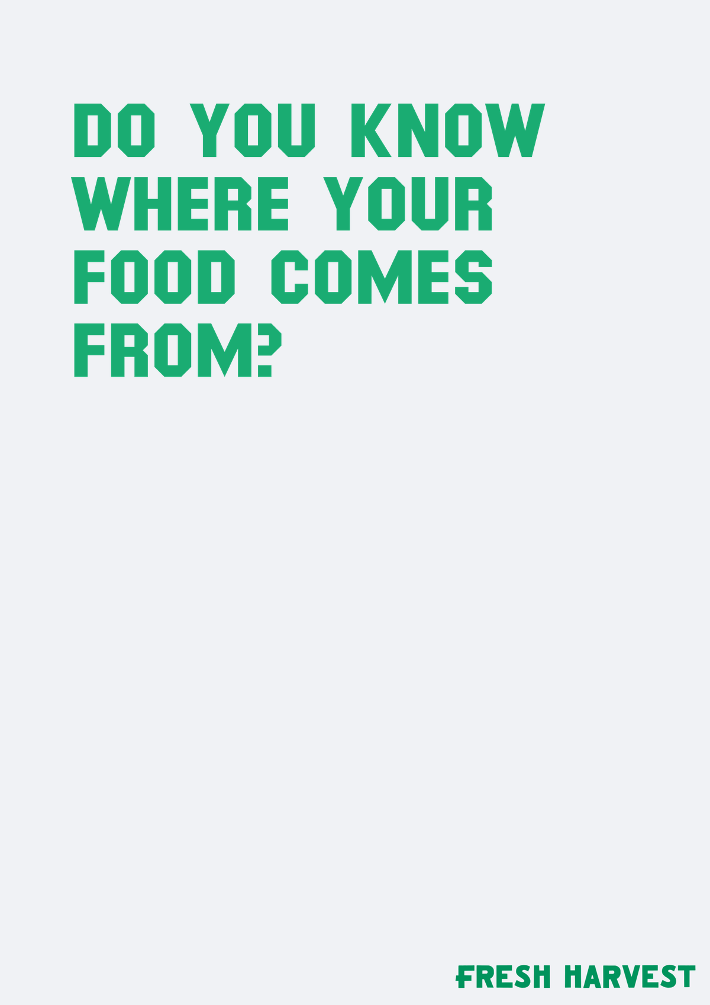



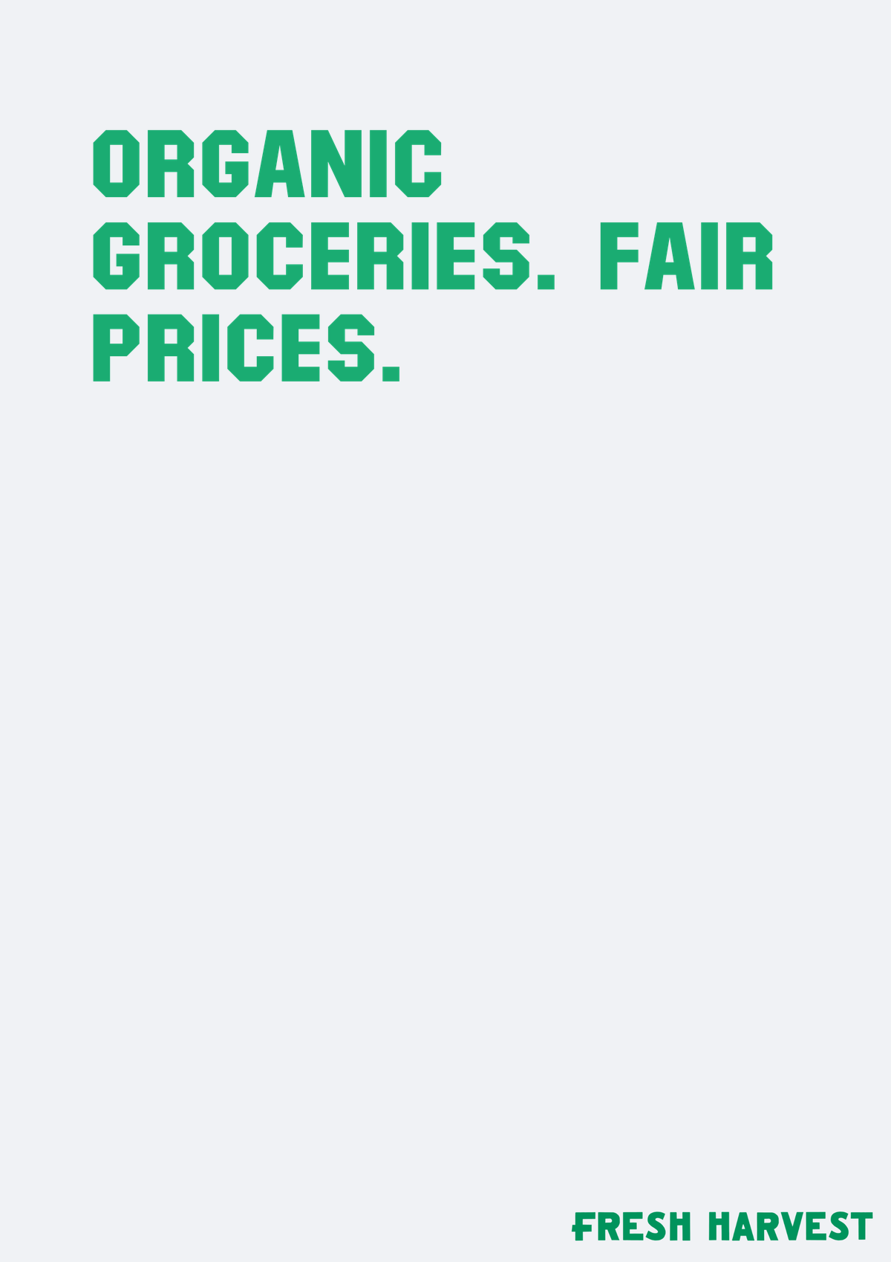
KEY FINDINGS: HEADLINES · 1 of 2
Headline Visit Our Booth For 50 Off leads the headlines set
Every option is at or above the baseline. Headline Visit Our Booth For 50 Off is furthest ahead at +11.
Headline…
Headline Win…
Headline…
HEADLINES PREFERENCES
+11
+10
+6
Headline Visit Our
Booth For 50 Off
+11
Headline Win A Free
Month Of Groceries
+10
Headline Guess The
Price Of Our Box To…
+6
Headline Good Food
For Every Table
+4
Headline Good…
Headline Do…
Headline…
Headline Do You Know
Where Your Food Comes…
+3
+4
+3
+3
Headline Georgia
Farms Delivered
+3
Headline Good For
People And The Planet
+3
Headline Metro
Atlanta’s Online…
+3
Headline Organic
Groceries Fair Prices
+3
Headline Good…
Headline…
Headline…
0
5
10
15
+3
+3
+3
Key read: Headline Visit Our Booth For 50 Off is the strongest headlines direction (+11). The gap to Headline Prefer Big Grocery Chains Keep Walking is +11 points.
n=312 respondents. Top-2 Box model (ratings 4–5): element lifts show movement above or below the model baseline.
13

Slide 14
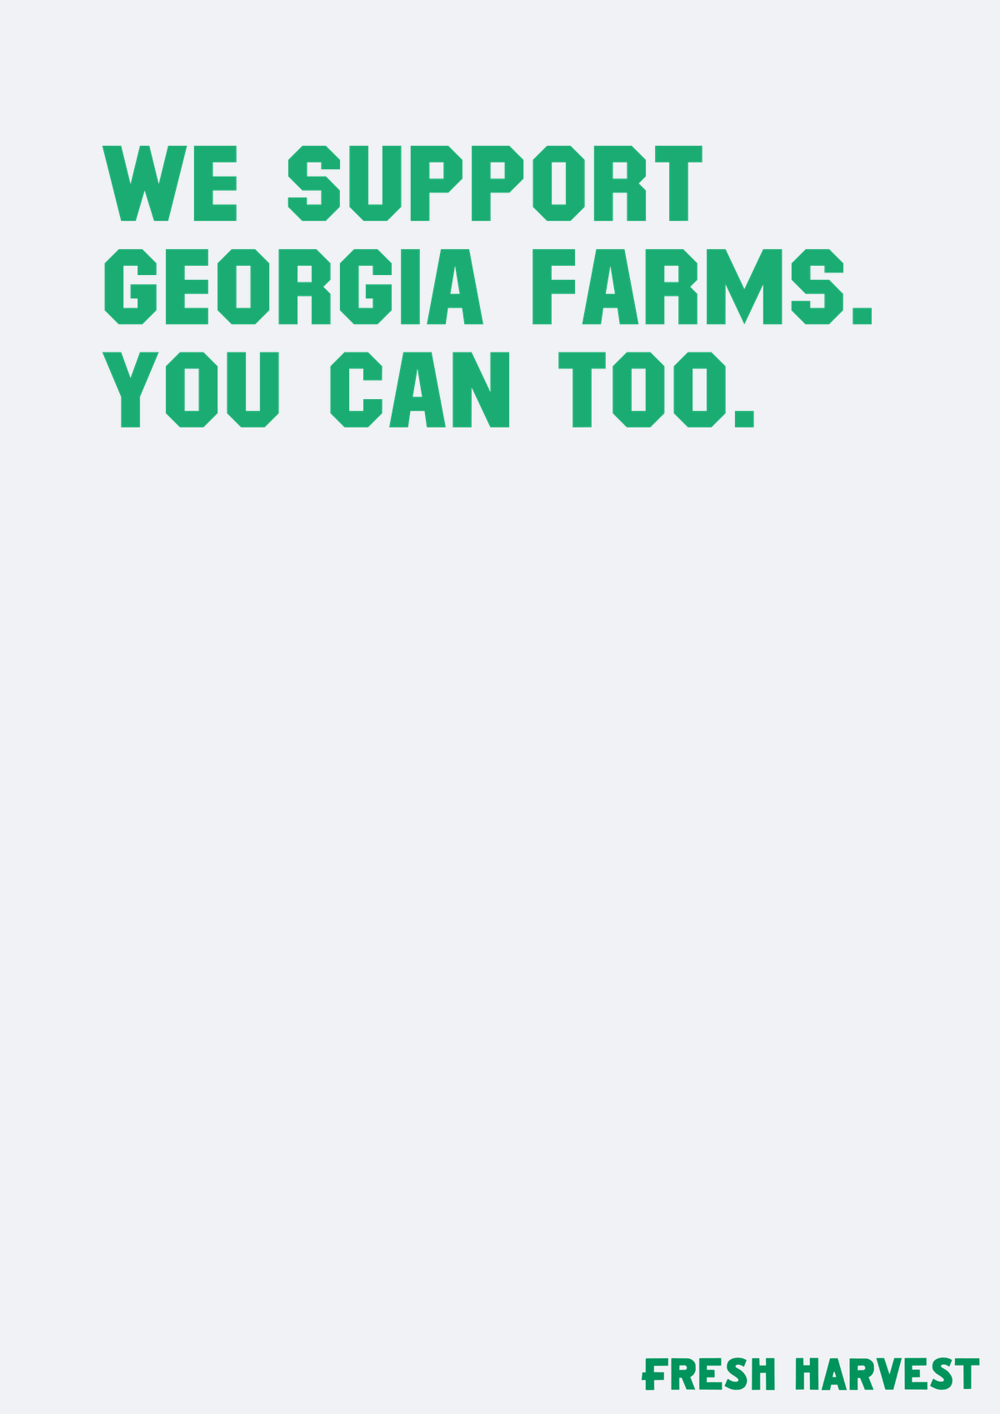
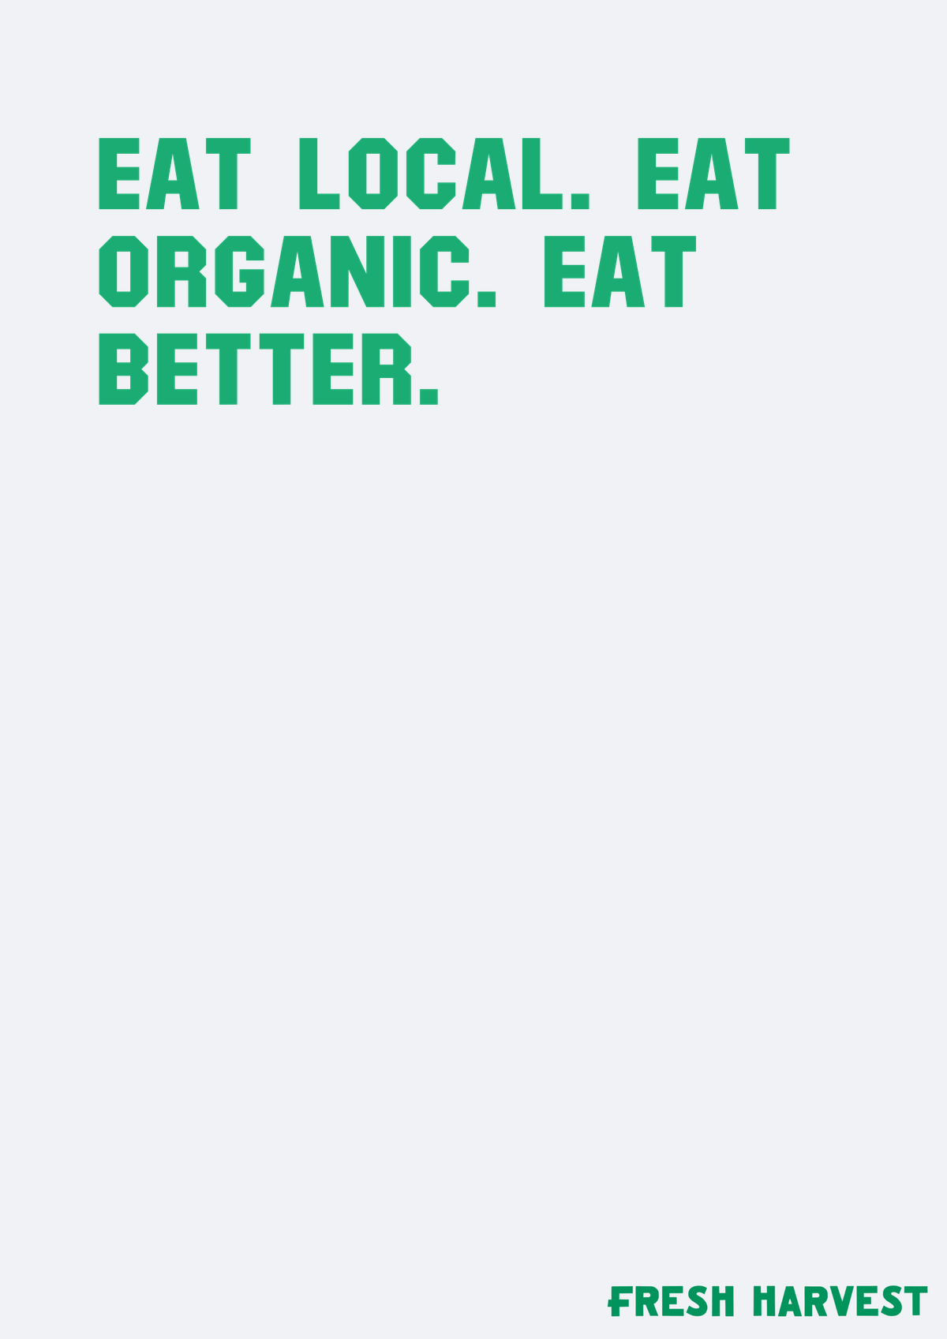
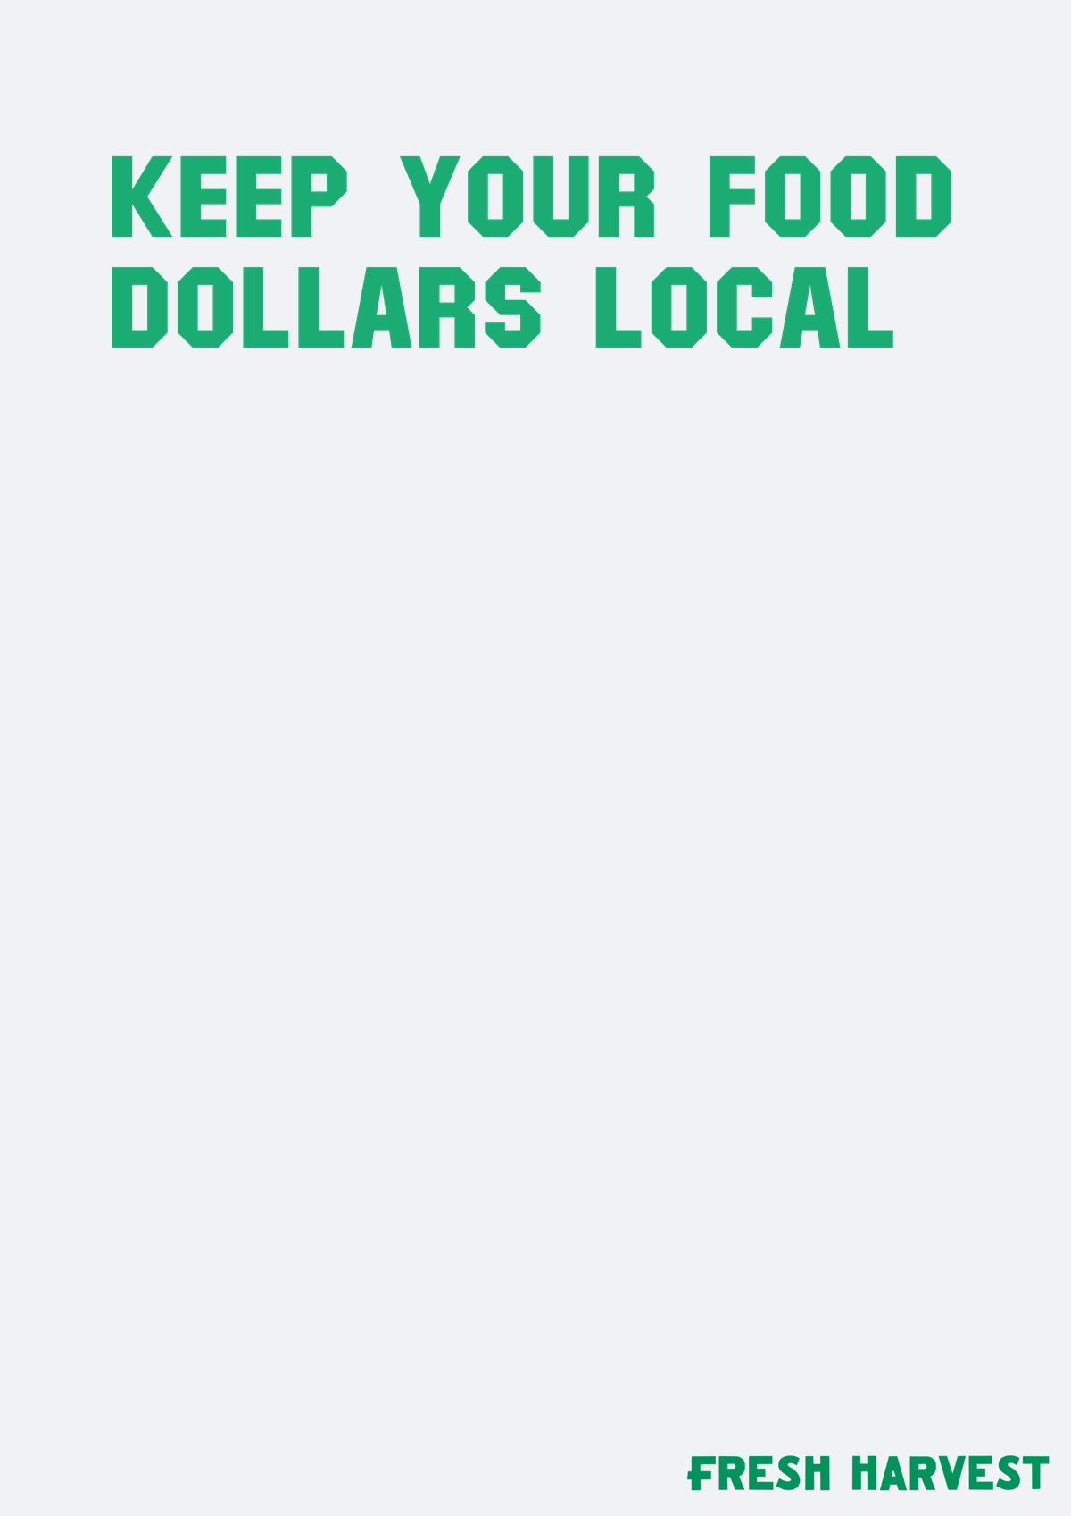
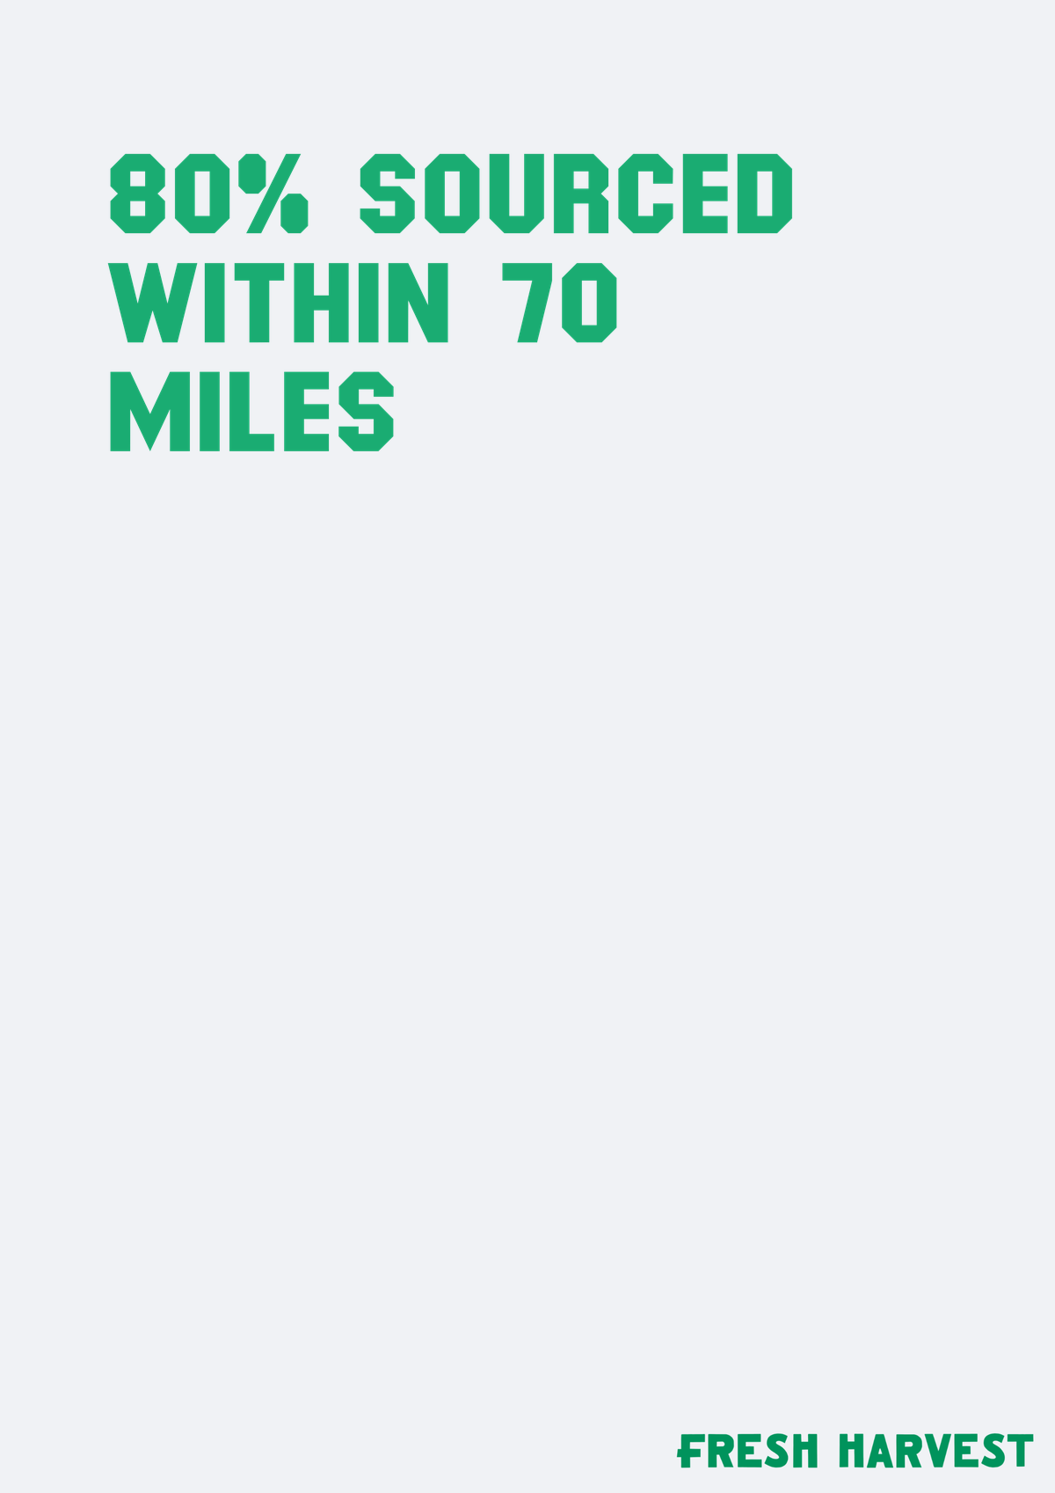
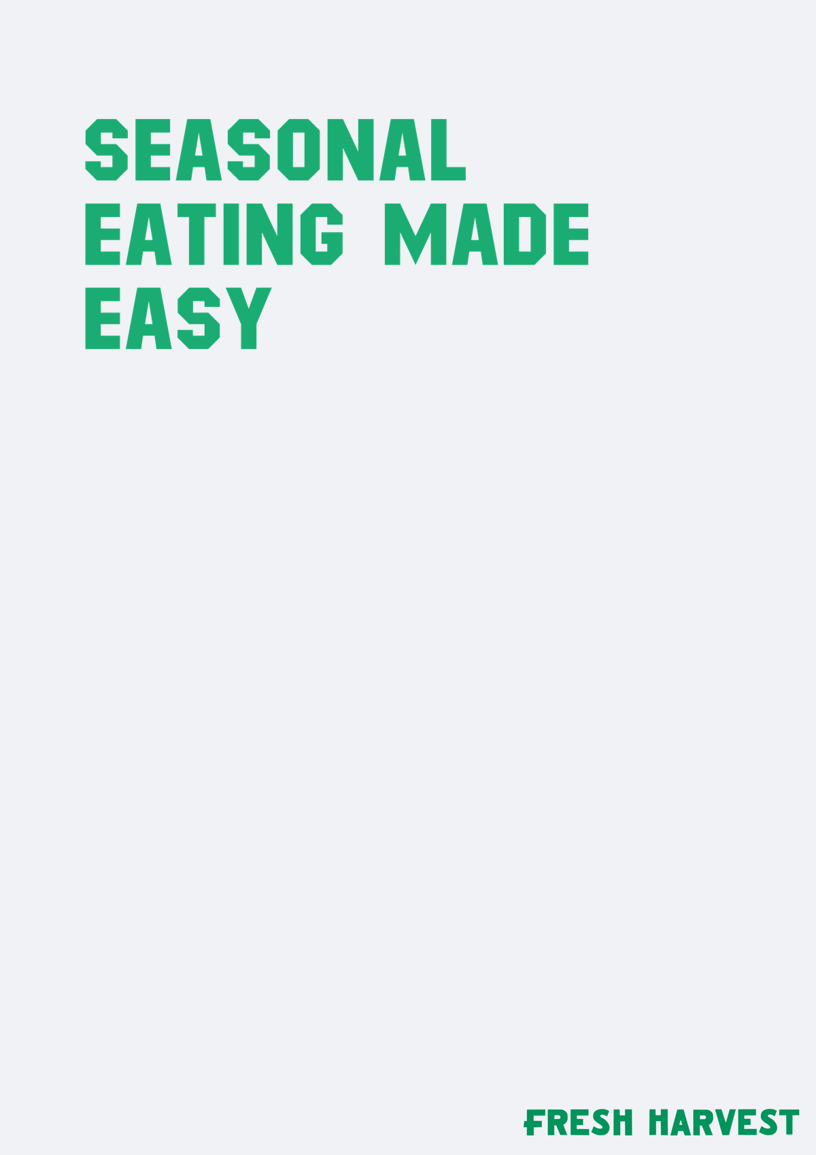
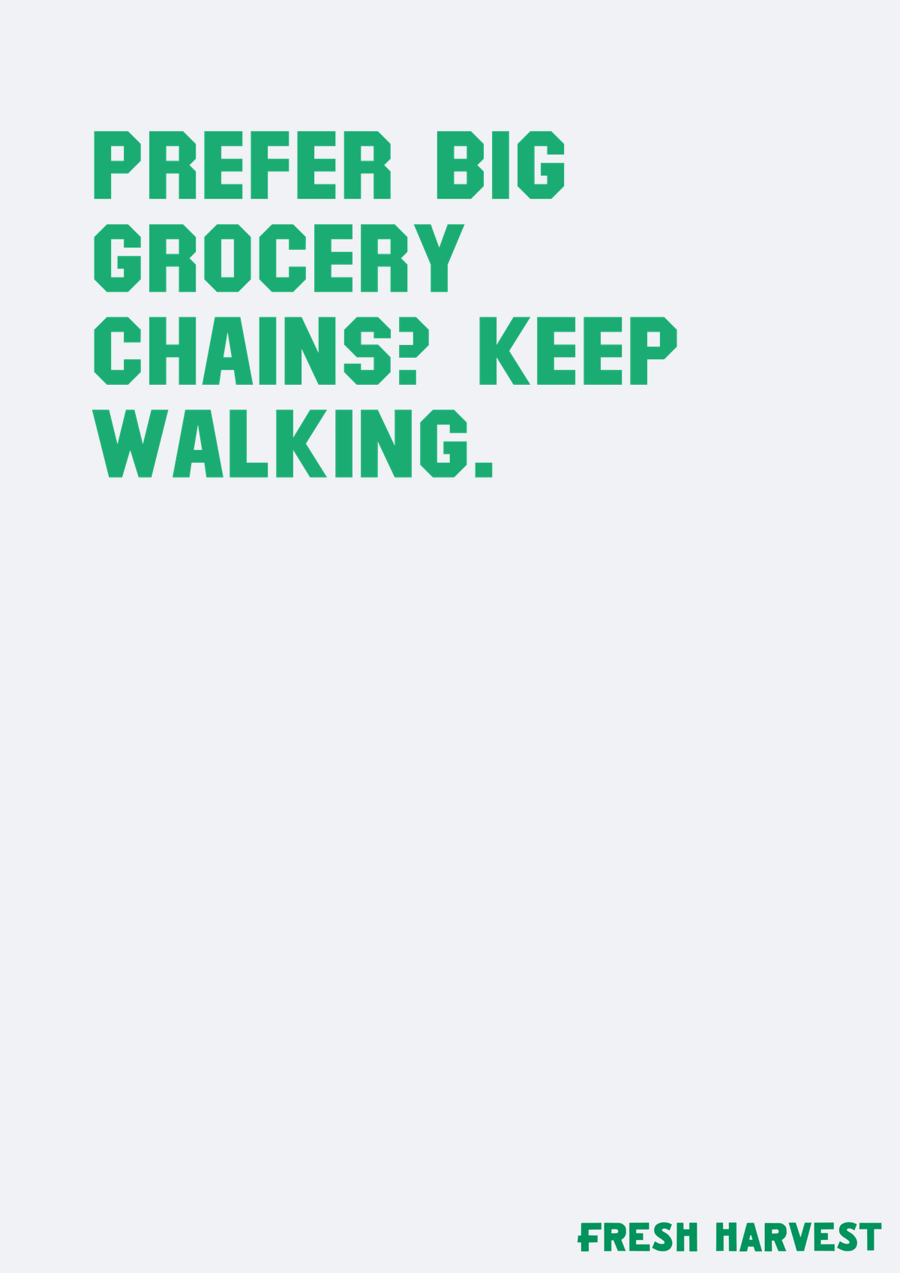

KEY FINDINGS: HEADLINES · 2 of 2
Headline Visit Our Booth For 50 Off leads the headlines set
Every option is at or above the baseline. Headline Visit Our Booth For 50 Off is furthest ahead at +11.
Headline We…
Headline Eat…
Headline Keep…
HEADLINES PREFERENCES
+3
+2
+2
Headline We Support
Georgia Farms You Can…
+3
Headline Eat Local Eat
Organic Eat Better
+2
Headline Keep Your
Food Dollars Local
+2
Headline 80…
Headline…
Headline…
Headline 80 Sourced
Within 70 Miles
+2
+2
+1
0
Headline Seasonal
Eating Made Easy
+1
Headline Prefer Big
Grocery Chains Keep…
0
Headline Skip The
Grocery Store
0
Headline Skip…
0
1
2
3
4
0
Key read: Headline Visit Our Booth For 50 Off is the strongest headlines direction (+11). The gap to Headline Prefer Big Grocery Chains Keep Walking is +11 points.
n=312 respondents. Top-2 Box model (ratings 4–5): element lifts show movement above or below the model baseline.
14

Slide 15



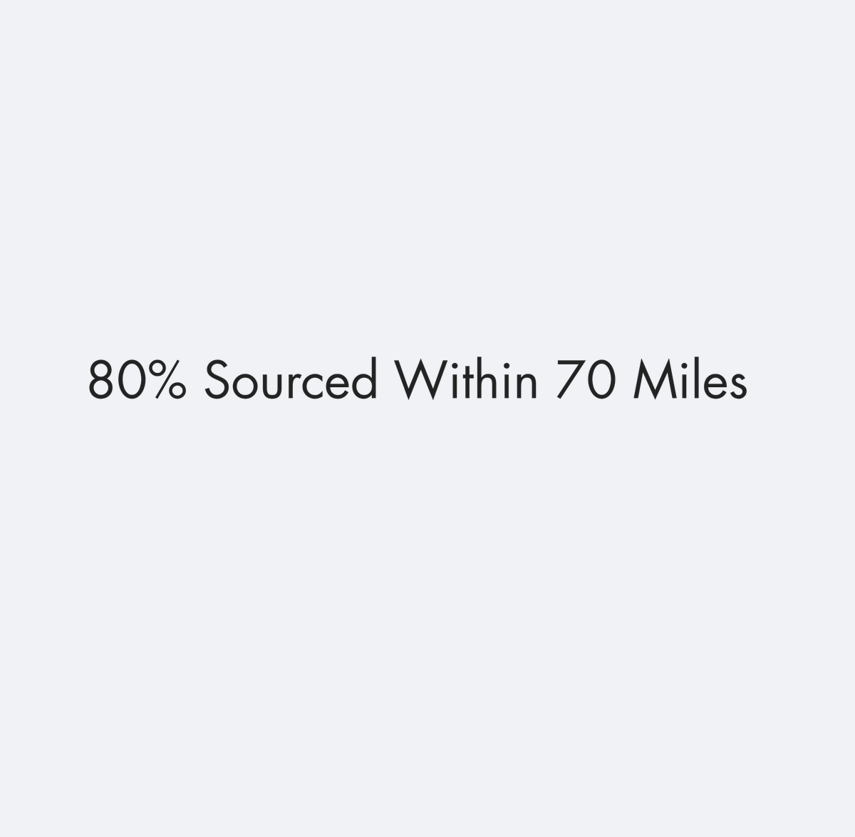


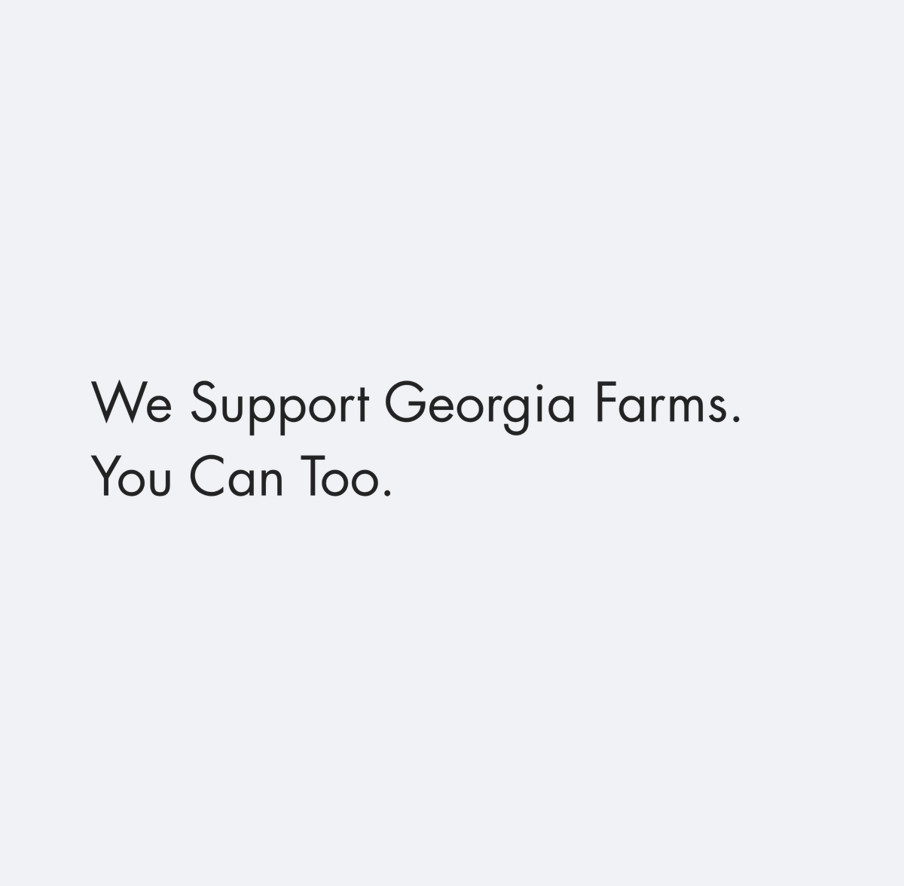
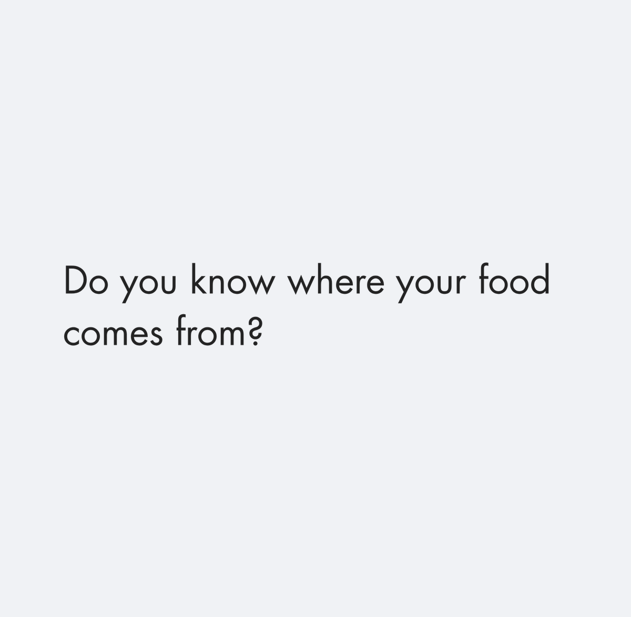

KEY FINDINGS: SUB HEADERS · 1 of 2
Sub Header Win A Free Month Of Groceries! creates the clearest sub headers lift
Sub Header Win A Free Month Of Groceries! leads at +6, while Sub Header Prefer Big Grocery Chains Keep Walking pulls appeal the other way at -3.
Sub Header…
Sub Header…
Sub Header…
SUB HEADERS PREFERENCES
+6
+5
+2
Sub Header Win A Free
Month Of Groceries!
+6
Sub Header Visit Our
Booth For 50 Off
+5
Sub Header Guess The
Price Of Our Box To…
+2
Sub Header 80 Sourced
Within 70 Miles
+1
Sub Header 80…
Sub Header…
Sub Header…
Sub Header Good Food
For Every Table
+1
+1
+1
+1
Sub Header Metro
Atlanta’s Online…
+1
Sub Header We Support
Georgia Farms You Can…
+1
Sub Header Do You Know
Where Your Food Comes…
0
Sub Header Good For
People And The Planet
0
Sub Header We…
Sub Header Do…
Sub Header…
0
2
4
6
8
+1
0
0
Key read: Sub Header Win A Free Month Of Groceries! is the strongest sub headers direction (+6). The gap to Sub Header Prefer Big Grocery Chains Keep Walking is +9 points.
n=312 respondents. Top-2 Box model (ratings 4–5): element lifts show movement above or below the model baseline.
15

Slide 16
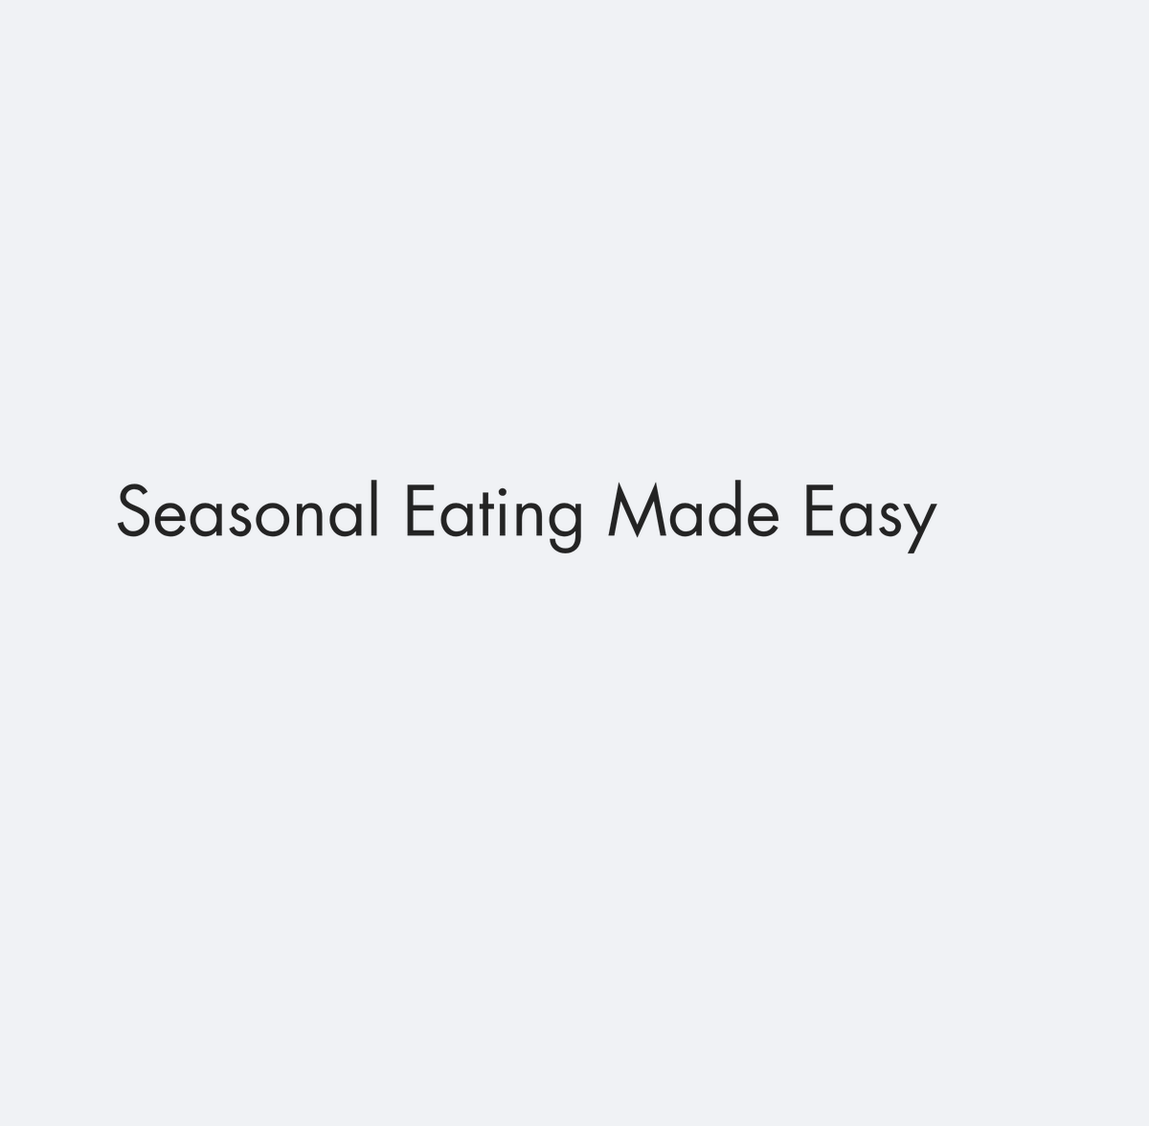

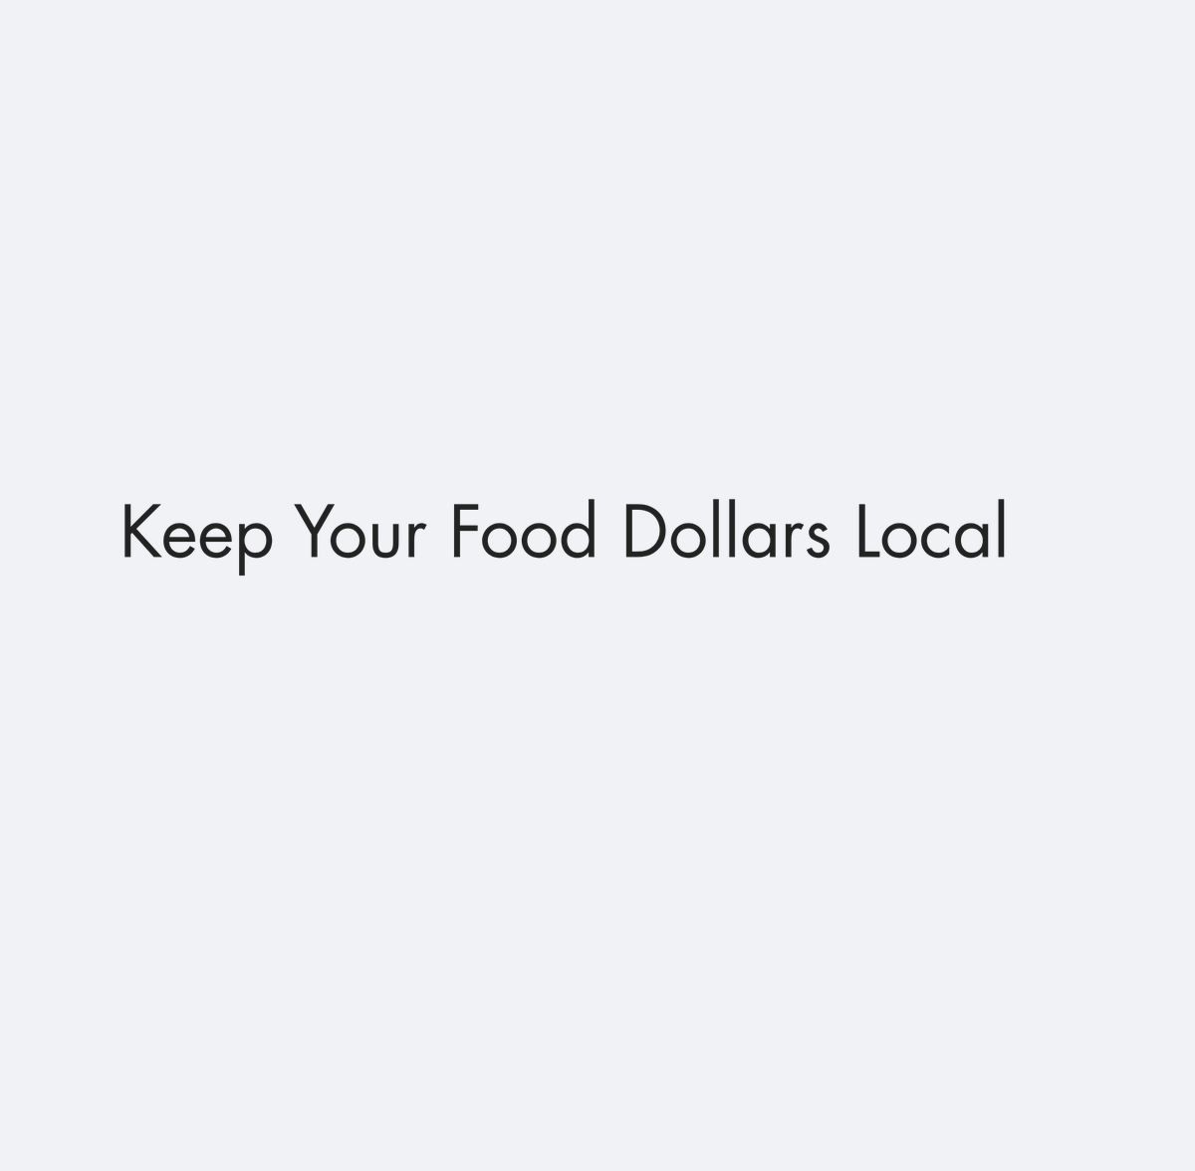
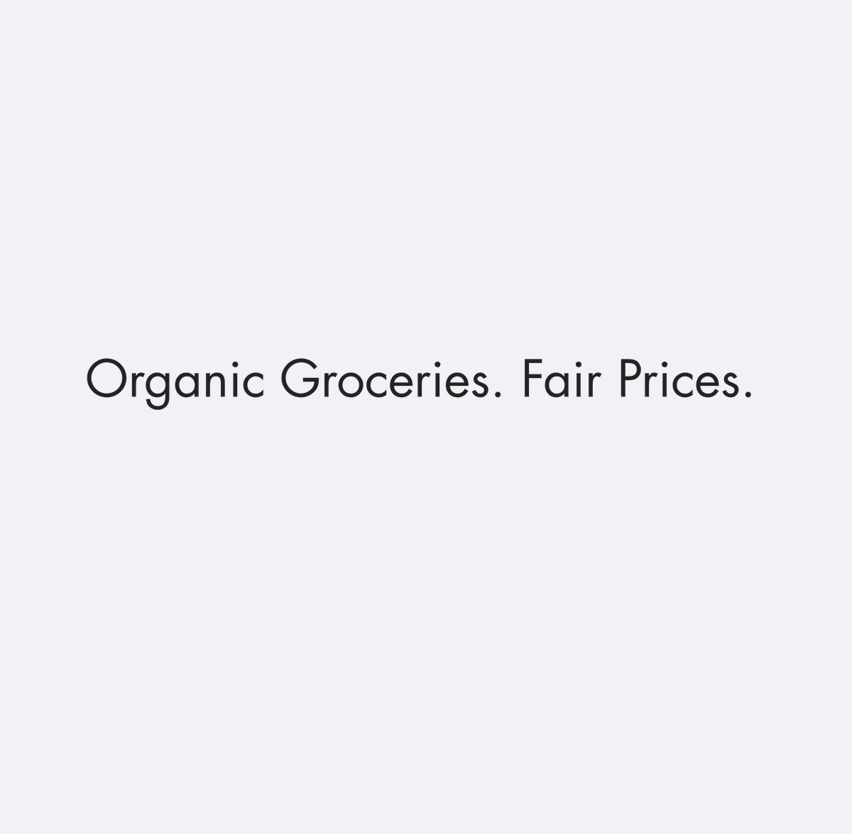
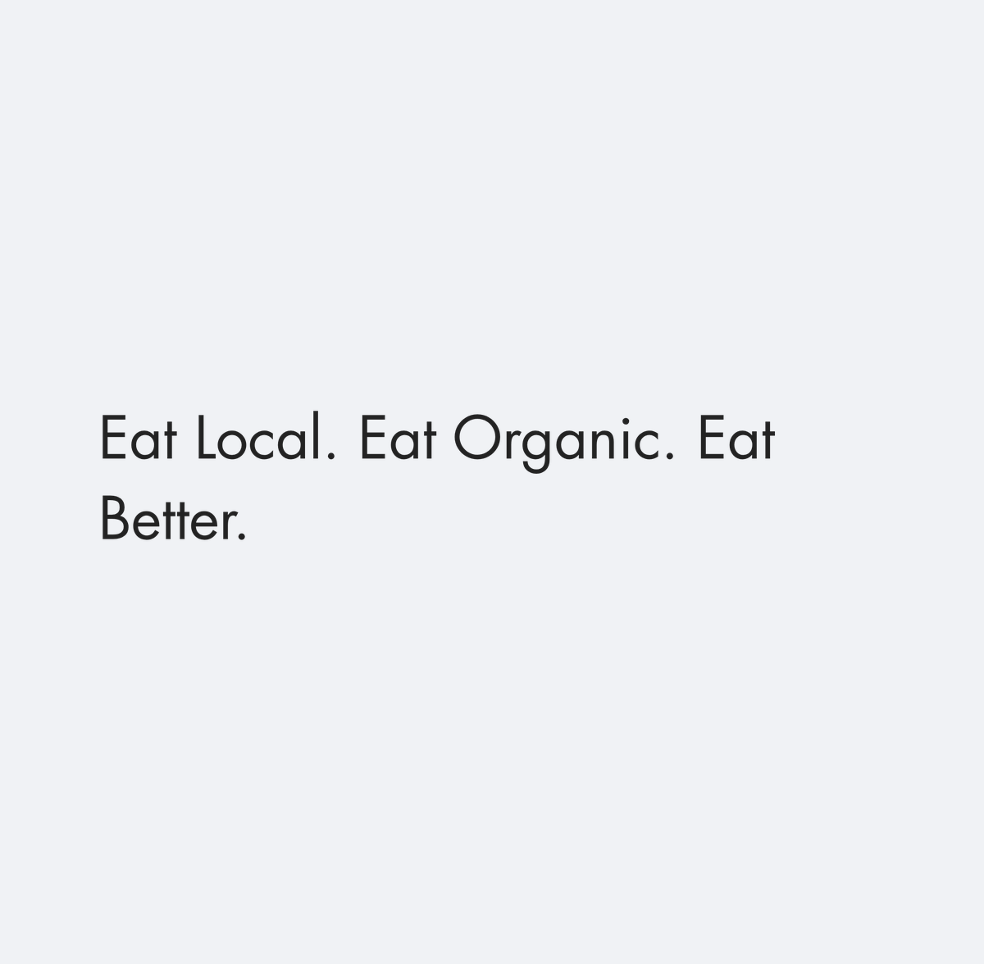

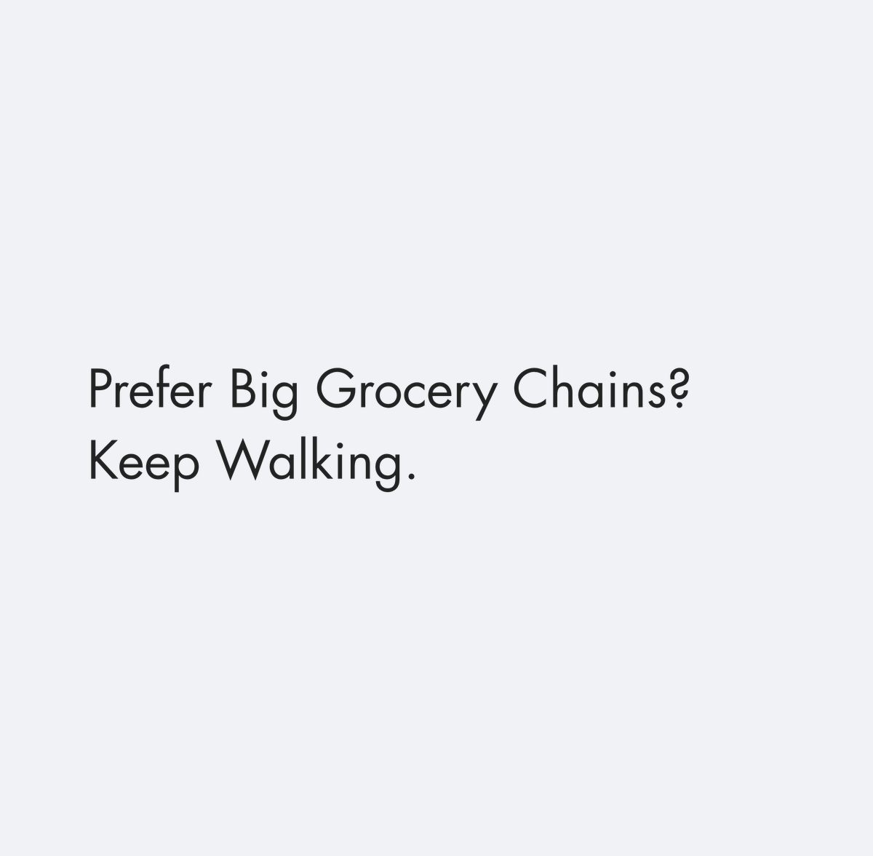
KEY FINDINGS: SUB HEADERS · 2 of 2
Sub Header Win A Free Month Of Groceries! creates the clearest sub headers lift
Sub Header Win A Free Month Of Groceries! leads at +6, while Sub Header Prefer Big Grocery Chains Keep Walking pulls appeal the other way at -3.
Sub Header…
Sub Header…
Sub Header…
SUB HEADERS PREFERENCES
0
-1
-1
Sub Header Seasonal
Eating Made Easy
0
Sub Header Georgia
Farms Delivered
-1
Sub Header Keep Your
Food Dollars Local
-1
Sub Header…
Sub Header…
Sub Header…
Sub Header Organic
Groceries Fair Prices
-1
-1
-2
-2
Sub Header Eat Local
Eat Organic Eat Better
-2
Sub Header Skip The
Grocery Store
-2
Sub Header Prefer Big
Grocery Chains Keep…
-3
Sub Header…
-4
-3
-2
-1
0
-3
Key read: Sub Header Win A Free Month Of Groceries! is the strongest sub headers direction (+6). The gap to Sub Header Prefer Big Grocery Chains Keep Walking is +9 points.
n=312 respondents. Top-2 Box model (ratings 4–5): element lifts show movement above or below the model baseline.
16

Slide 17
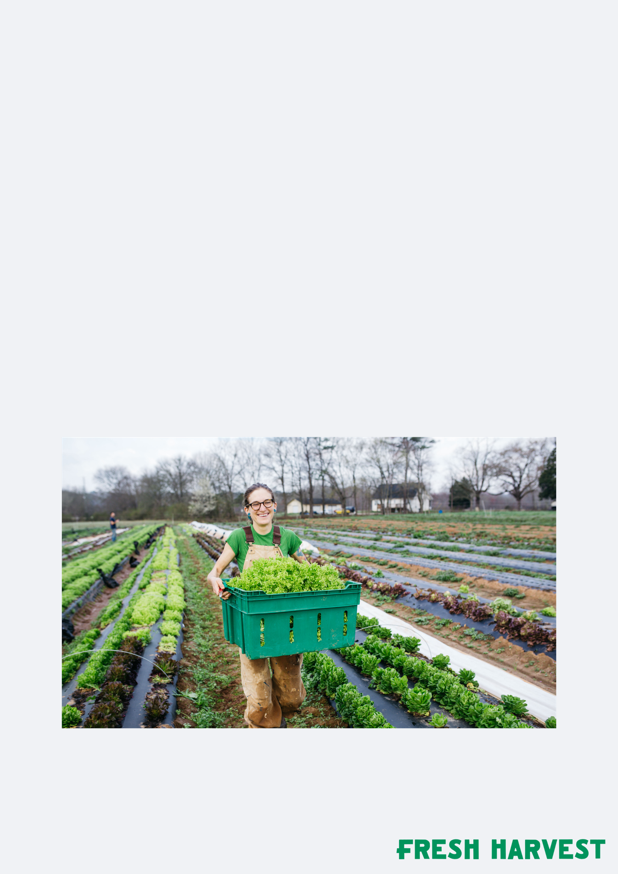
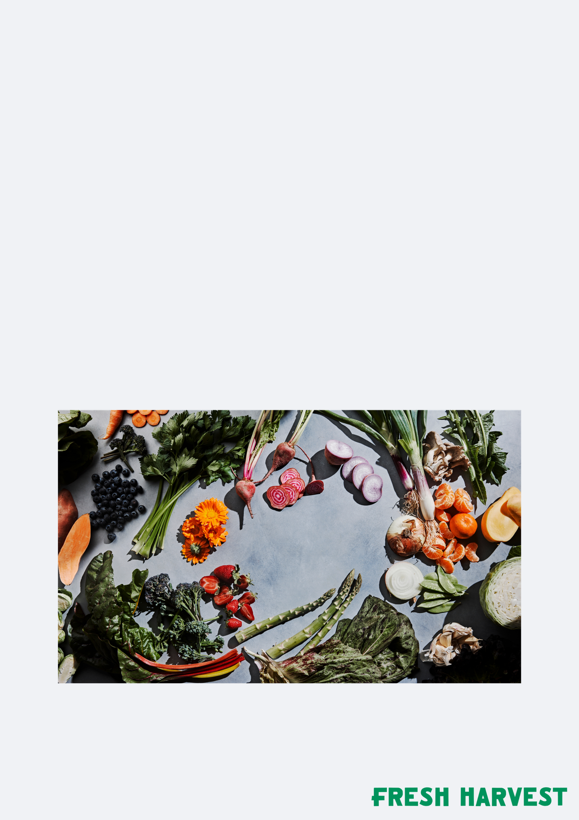

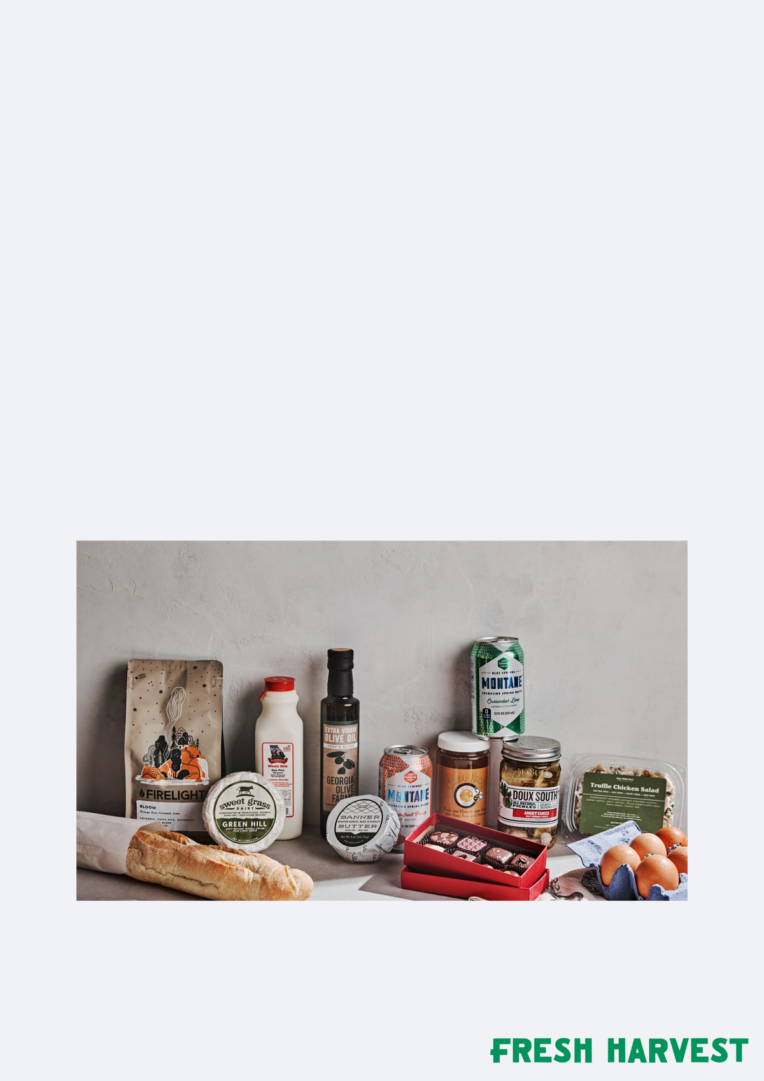
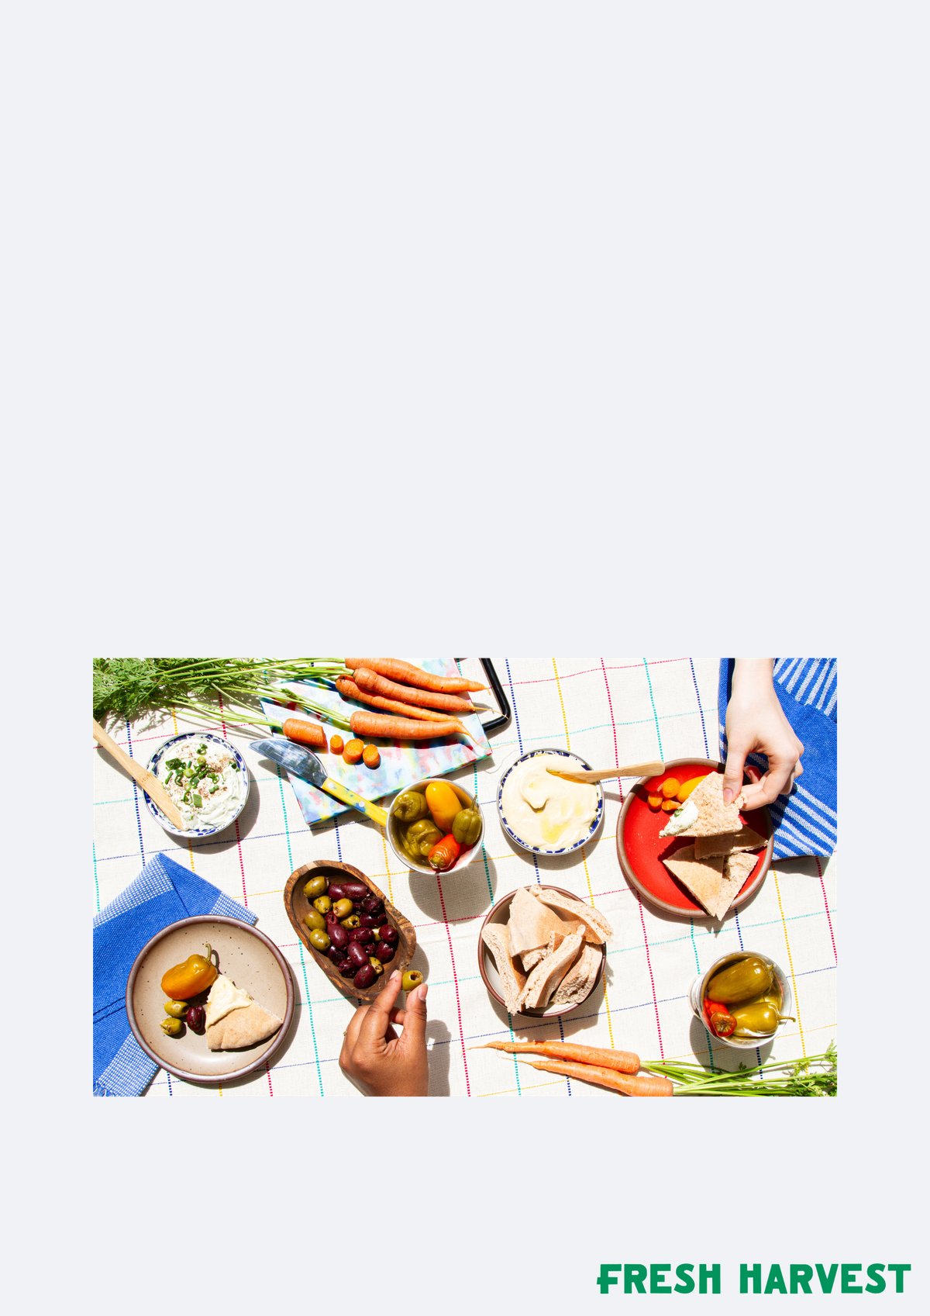
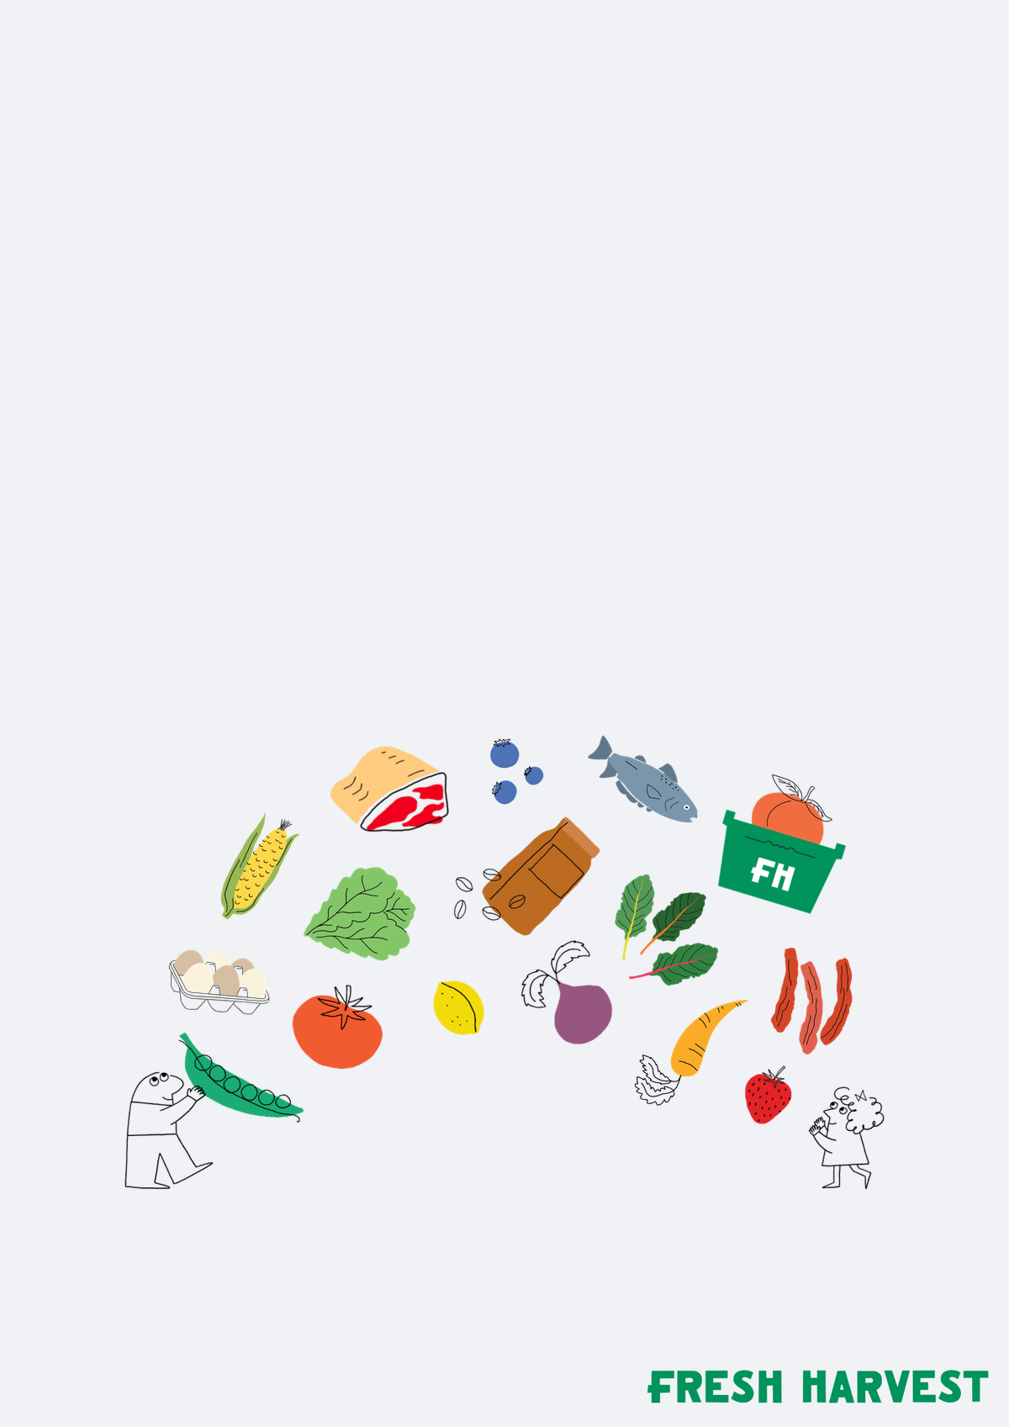
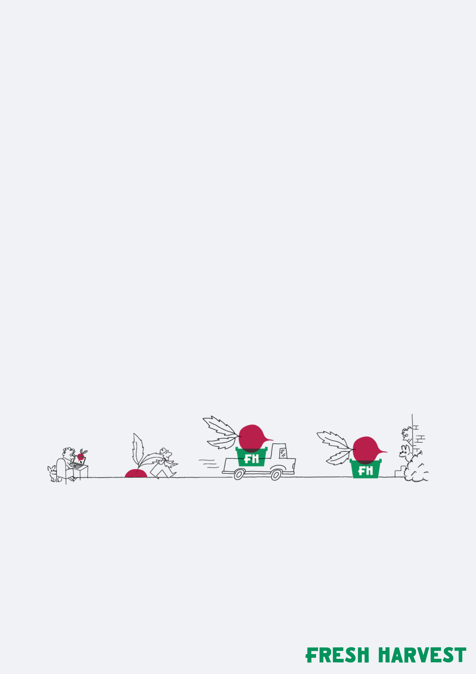
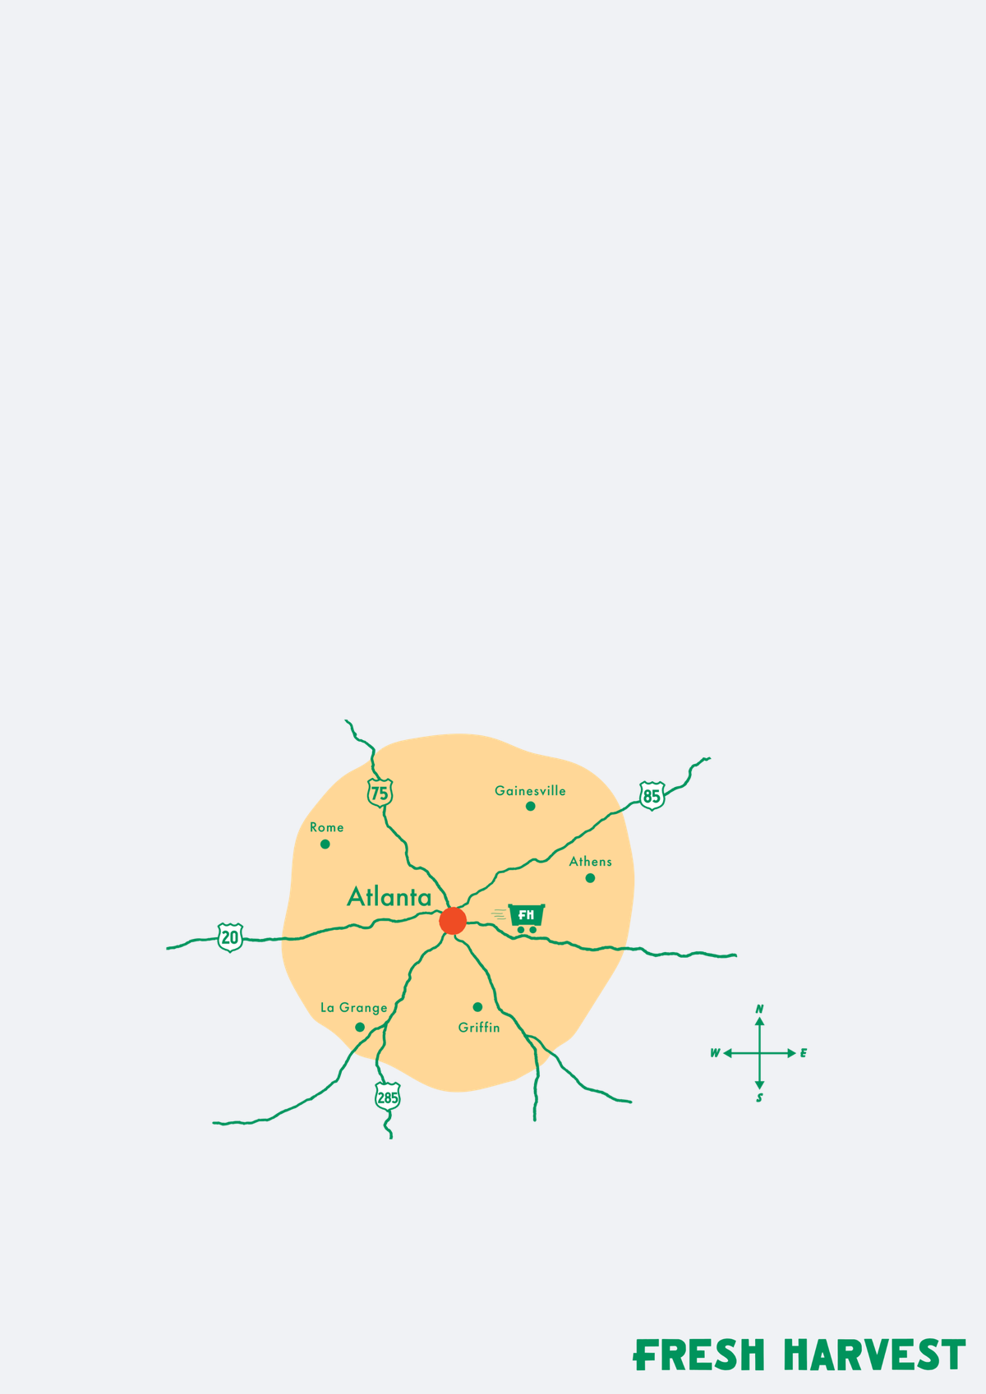
KEY FINDINGS: IMAGES
Image Layer Farm leads the images set
Every option is at or above the baseline. Image Layer Farm is furthest ahead at +7.
Image Layer…
Image Layer…
Image Layer…
IMAGES PREFERENCES
+7
+7
+6
Image Layer Farm
+7
Image Layer Produce
+7
Image Layer Box
+6
Image Layer Grocery
+6
Image Layer…
Image Layer…
Image Layer…
+6
+6
+4
Image Layer
Lifestyle
+6
Image Layer Box
Graphic
+4
Image Layer Delivery
Graphic
+2
Image Layer Map
Graphic
+2
Image Layer…
Image Layer…
0
2
4
6
8
+2
+2
Key read: Image Layer Farm is the strongest images direction (+7). The gap to Image Layer Delivery Graphic is +5 points.
n=312 respondents. Top-2 Box model (ratings 4–5): element lifts show movement above or below the model baseline.
17

Slide 18



KEY FINDINGS: CTA · 1 of 2
Cta Visit Our Booth For 50 Off creates the clearest cta lift
Cta Visit Our…
Cta Win A…
Cta Organic…
Cta Visit Our Booth For 50 Off leads at +3, while Cta Skip The Grocery Store pulls appeal the other way at -4.
+3
+3
+2
CTA PREFERENCES
Cta Visit Our Booth
For 50 Off
+3
Cta Win A Free Month
Of Groceries!
+3
Cta Organic
Groceries Fair…
+2
Cta Guess The…
Cta Good Food…
Cta Good For…
+1
0
0
Cta Guess The Price Of
Our Box To Win!
+1
Cta Good Food For
Every Table
0
Cta Good For People
And The Planet
0
Cta 80 Sourced
Within 70 Miles
-1
Cta 80…
Cta Do You…
Cta Georgia…
Cta Do You Know Where
Your Food Comes From
-1
-1
-1
-1
Cta Georgia Farms
Delivered
-1
-2
0
2
4
Key read: Cta Visit Our Booth For 50 Off is the strongest cta direction (+3). The gap to Cta Skip The Grocery Store is +7 points.
n=312 respondents. Top-2 Box model (ratings 4–5): element lifts show movement above or below the model baseline.
18

Slide 19




KEY FINDINGS: CTA · 2 of 2
Cta Visit Our Booth For 50 Off creates the clearest cta lift
Cta Seasonal…
Cta Eat Local…
Cta Keep Your…
Cta Visit Our Booth For 50 Off leads at +3, while Cta Skip The Grocery Store pulls appeal the other way at -4.
-1
-2
-2
CTA PREFERENCES
Cta Seasonal Eating
Made Easy
-1
Cta Eat Local Eat
Organic Eat Better
-2
Cta Metro…
Cta Prefer…
Cta We…
Cta Keep Your Food
Dollars Local
-2
-2
-2
-2
Cta Metro Atlanta’s
Online Farmers Market
-2
Cta Prefer Big Grocery
Chains Keep Walking
-2
Cta We Support Georgia
Farms You Can Too
-2
Cta Skip The…
Cta Skip The Grocery
Store
-4
-4
-6
-4
-2
0
Key read: Cta Visit Our Booth For 50 Off is the strongest cta direction (+3). The gap to Cta Skip The Grocery Store is +7 points.
n=312 respondents. Top-2 Box model (ratings 4–5): element lifts show movement above or below the model baseline.
19

Slide 20


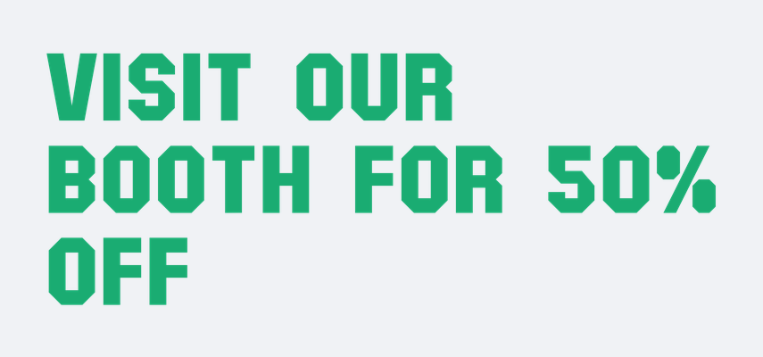

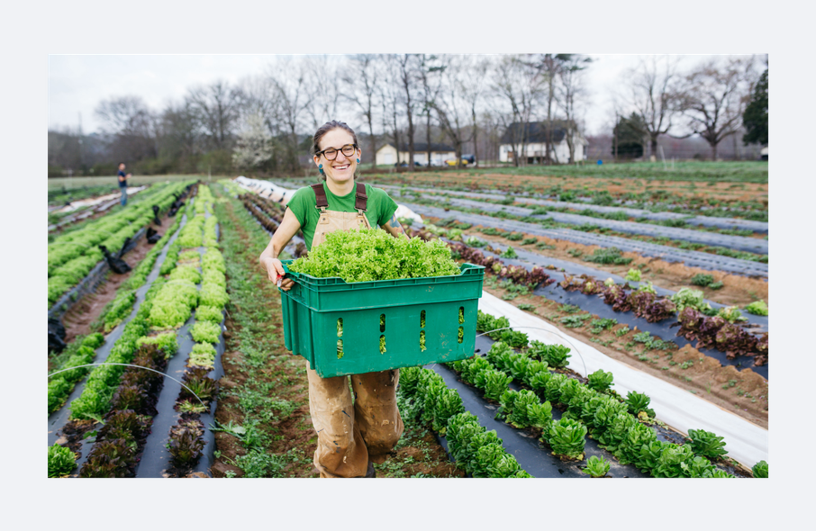
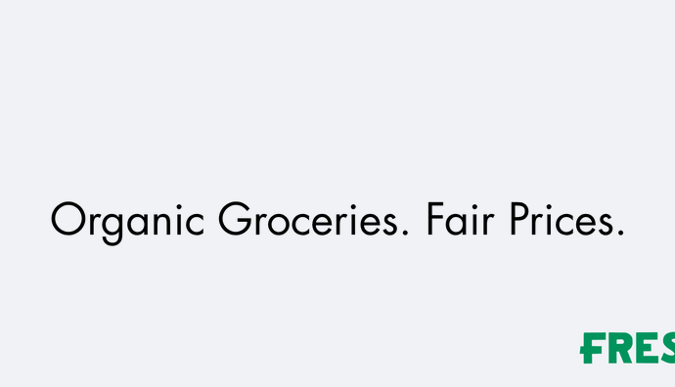
KEY FINDINGS: COMBINED PACK
Highest-lift layers, stacked into one pack
One element from every silo — the strongest mix the pairing rules allow. The same message is not used twice. The background sits underneath.
01
Backgrounds · Background Layer Cotton
+1
02
Headlines · Headline Visit Our Booth For 50 Off
+11
03
Sub Headers · Sub Header Win A Free Month Of Groceries!
+6
04
Images · Image Layer Farm
+7
05
CTA · Cta Organic Groceries Fair Prices
+2
Base 50% · layer lift +27
n=312 respondents. Top-2 Box model (ratings 4–5): element lifts show movement above or below the model baseline.
20

Slide 21
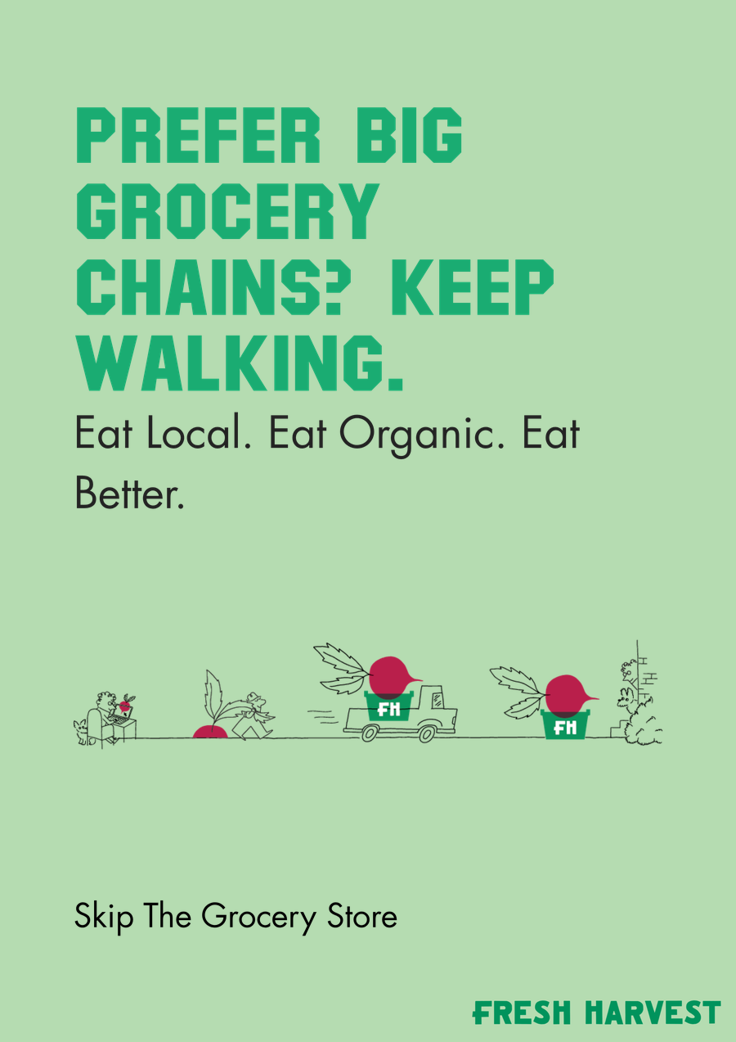

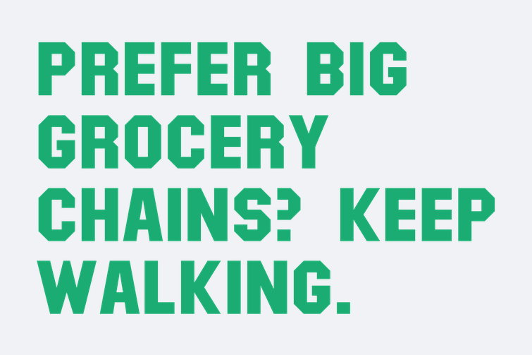
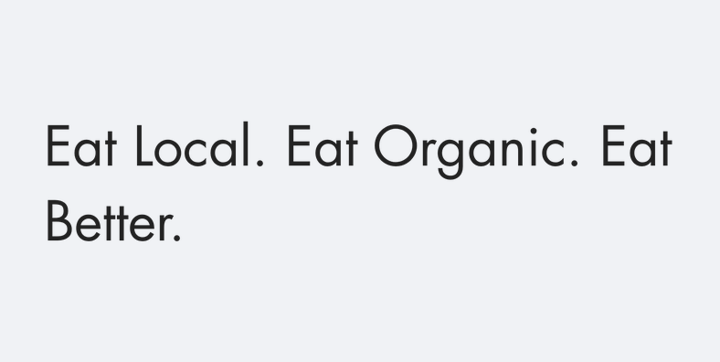
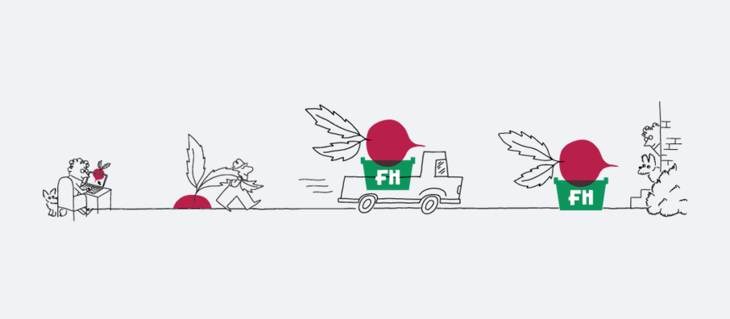

KEY FINDINGS: COMBINED PACK
Lowest-lift layers, stacked into one pack
The same silos and stacking order, using the weakest mix the pairing rules allow. The same message is not used twice.
01
Backgrounds · Background Layer Mint
0
02
Headlines · Headline Prefer Big Grocery Chains Keep Walking
0
03
Sub Headers · Sub Header Eat Local Eat Organic Eat Better
-2
04
Images · Image Layer Delivery Graphic
+2
05
CTA · Cta Skip The Grocery Store
-4
Base 50% · layer lift -4
n=312 respondents. Top-2 Box model (ratings 4–5): element lifts show movement above or below the model baseline.
21

Slide 22
KEY FINDINGS: BUILD COMPARISON
The higher-lift build against the lower-lift build
HIGHER-LIFT BUILD
LOWER-LIFT BUILD
+27
-4
over 50% base
over 50% base
Backgrounds
Cotton
+1
Backgrounds
Mint
0
Headlines
Visit Our Booth For 50 Off
+11
Headlines
Prefer Big Grocery Chains Keep Walking
0
Sub Headers
Win A Free Month Of Groceries!
+6
Sub Headers
Eat Local Eat Organic Eat Better
-2
Images
Farm
+7
Images
Delivery Graphic
+2
CTA
Organic Groceries Fair Prices
+2
CTA
Skip The Grocery Store
-4
The higher-lift build leads by +31 points, from the same 50% base. Pairing rules keep the same message from appearing twice.
n=312 respondents. Top-2 Box model (ratings 4–5): element lifts show movement above or below the model baseline.
22

Slide 23
Appendix

Slide 24
APPENDIX · FULL ELEMENT LIFT SUMMARY
Every element, same model
Scores are Top-2 Box coefficients (ratings 4–5), rounded the same way as the charts. Green is lift above the baseline. Red is lift below it. A star means the coefficient cleared the study threshold.
50%
5
62
Base appeal
Silos in the tables
Elements scored
n=312 respondents. Top-2 Box model (ratings 4–5): element lifts show movement above or below the model baseline.
24

Slide 25
FULL ELEMENT LIFT SUMMARY
Headlines · 1 of 2
HEADLINES PREFERENCES
+11
+10
+6
+4
+3
+3
+3
+3
+3
0
5
10
15
n=312 respondents. Top-2 Box model (ratings 4–5): element lifts show movement above or below the model baseline.
25

Slide 26
FULL ELEMENT LIFT SUMMARY
Headlines · 2 of 2
HEADLINES PREFERENCES
+3
+2
+2
+2
+1
0
0
0
1
2
3
4
n=312 respondents. Top-2 Box model (ratings 4–5): element lifts show movement above or below the model baseline.
26

Slide 27
FULL ELEMENT LIFT SUMMARY
Sub Headers · 1 of 2
SUB HEADERS PREFERENCES
+6
+5
+2
+1
+1
+1
+1
0
0
0
2
4
6
8
n=312 respondents. Top-2 Box model (ratings 4–5): element lifts show movement above or below the model baseline.
27

Slide 28
FULL ELEMENT LIFT SUMMARY
Sub Headers · 2 of 2
SUB HEADERS PREFERENCES
0
-1
-1
-1
-2
-2
-3
-4
-3
-2
-1
0
n=312 respondents. Top-2 Box model (ratings 4–5): element lifts show movement above or below the model baseline.
28

Slide 29
FULL ELEMENT LIFT SUMMARY
CTA · 1 of 2
CTA PREFERENCES
+3
+3
+2
+1
0
0
-1
-1
-1
-2
0
2
4
n=312 respondents. Top-2 Box model (ratings 4–5): element lifts show movement above or below the model baseline.
29

Slide 30
FULL ELEMENT LIFT SUMMARY
CTA · 2 of 2
CTA PREFERENCES
-1
-2
-2
-2
-2
-2
-4
-6
-4
-2
0
n=312 respondents. Top-2 Box model (ratings 4–5): element lifts show movement above or below the model baseline.
30

Slide 31
FULL ELEMENT LIFT SUMMARY
Backgrounds · Images
BACKGROUNDS PREFERENCES
IMAGES PREFERENCES
+1
+7
+7
+1
+6
+1
+6
+1
+6
+4
+1
+2
0
+2
0
0
1
2
0
5
10
n=312 respondents. Top-2 Box model (ratings 4–5): element lifts show movement above or below the model baseline.
31

Slide 32
Element Assets

Slide 33






ELEMENT ASSETS
Backgrounds — element assets
A · 6 variations
Background Layer
Cotton
Background Layer
Cream
Background Layer
Lemon
Background Layer
Melon
Background Layer
Mint
Background Layer
Sky
n=312 respondents. Top-2 Box model (ratings 4–5): element lifts show movement above or below the model baseline.
33

Slide 34










ELEMENT ASSETS
Headlines — element assets · 1 of 2
B · 16 variations
Headline Do You
Know Where Your…
Headline Eat
Local Eat…
Headline Georgia
Farms Delivered
Headline Good
Food For Every…
Headline Good
For People And…
Headline Guess
The Price Of Our…
Headline Keep
Your Food…
Headline Metro
Atlanta’s Online…
Headline Organic
Groceries Fair…
Headline Prefer
Big Grocery…
n=312 respondents. Top-2 Box model (ratings 4–5): element lifts show movement above or below the model baseline.
34

Slide 35






ELEMENT ASSETS
Headlines — element assets · 2 of 2
B · 16 variations
Headline
Seasonal Eating…
Headline Skip
The Grocery…
Headline We
Support Georgia…
Headline Win A
Free Month Of…
Headline 80
Sourced Within…
Headline Visit
Our Booth For 50…
n=312 respondents. Top-2 Box model (ratings 4–5): element lifts show movement above or below the model baseline.
35

Slide 36
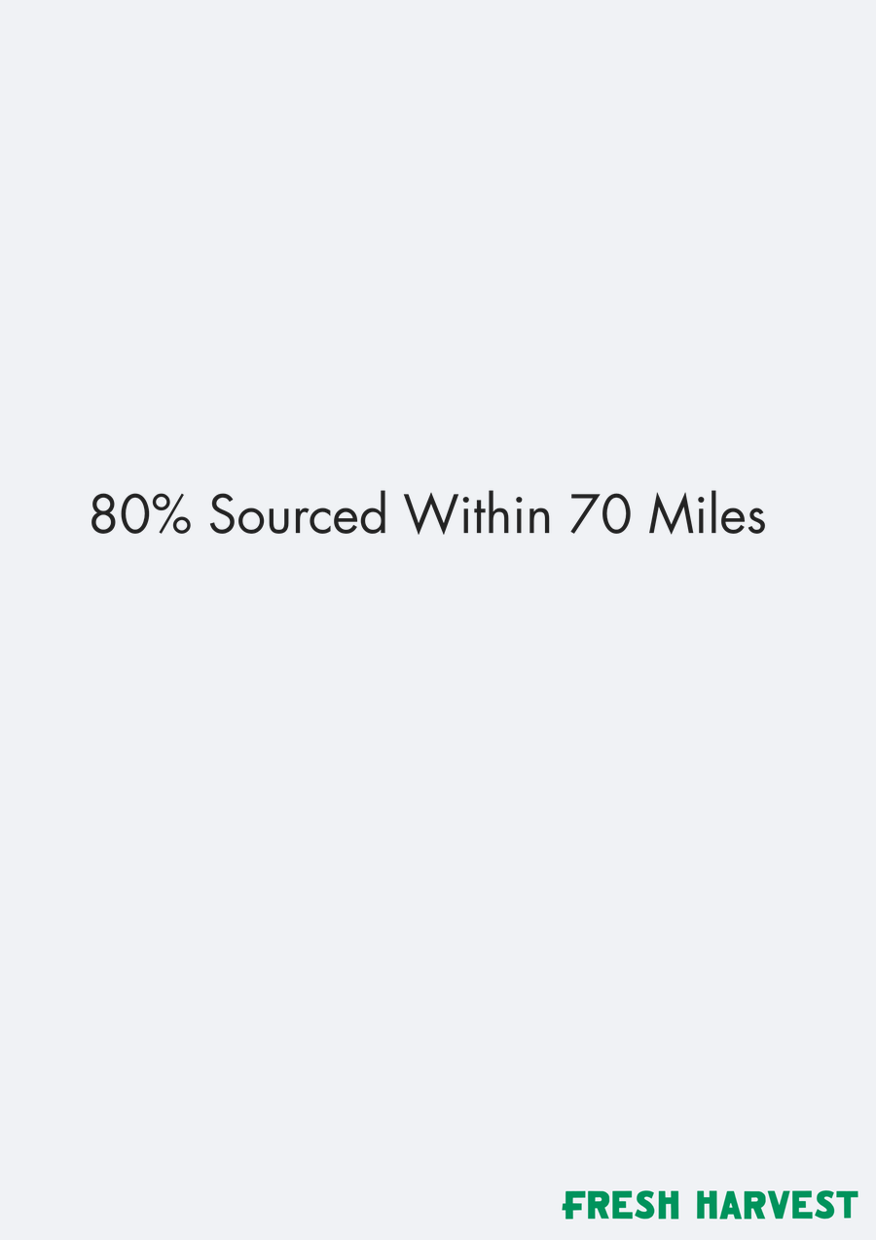
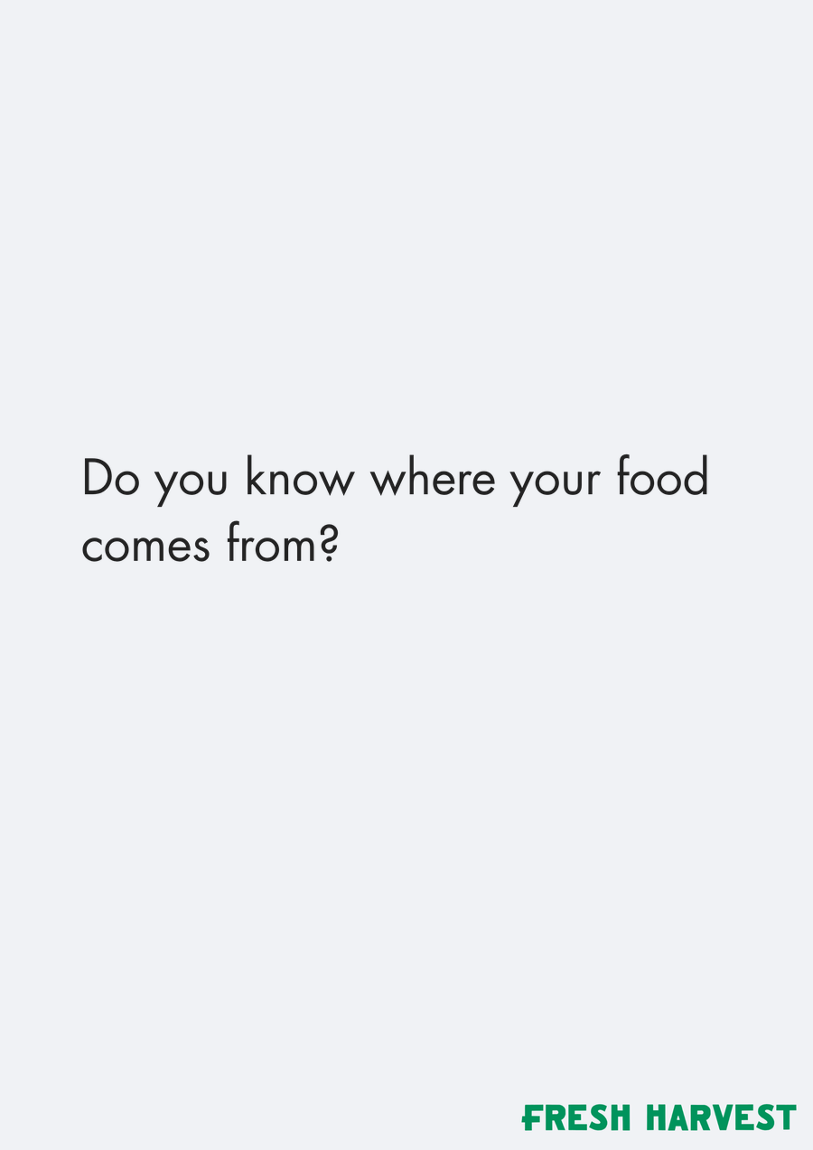
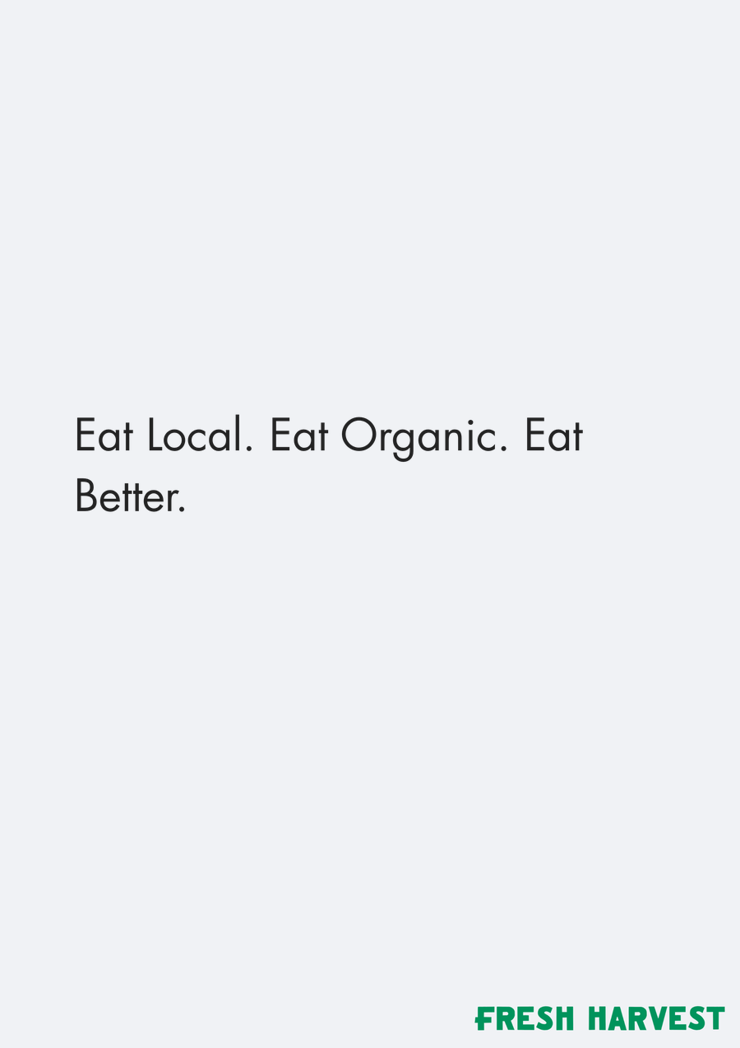
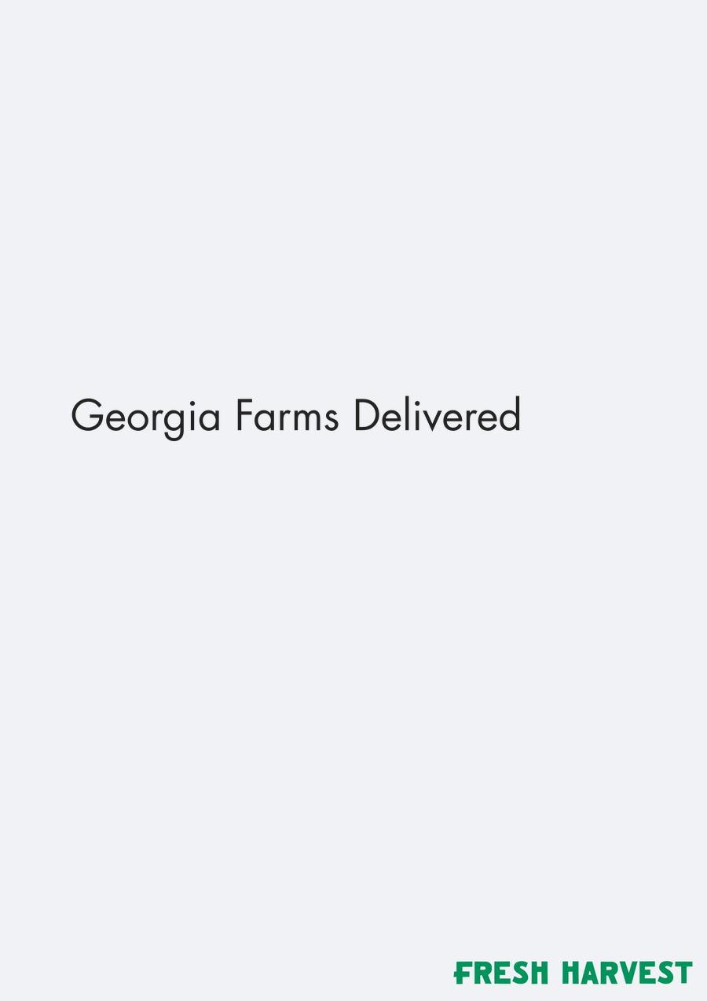
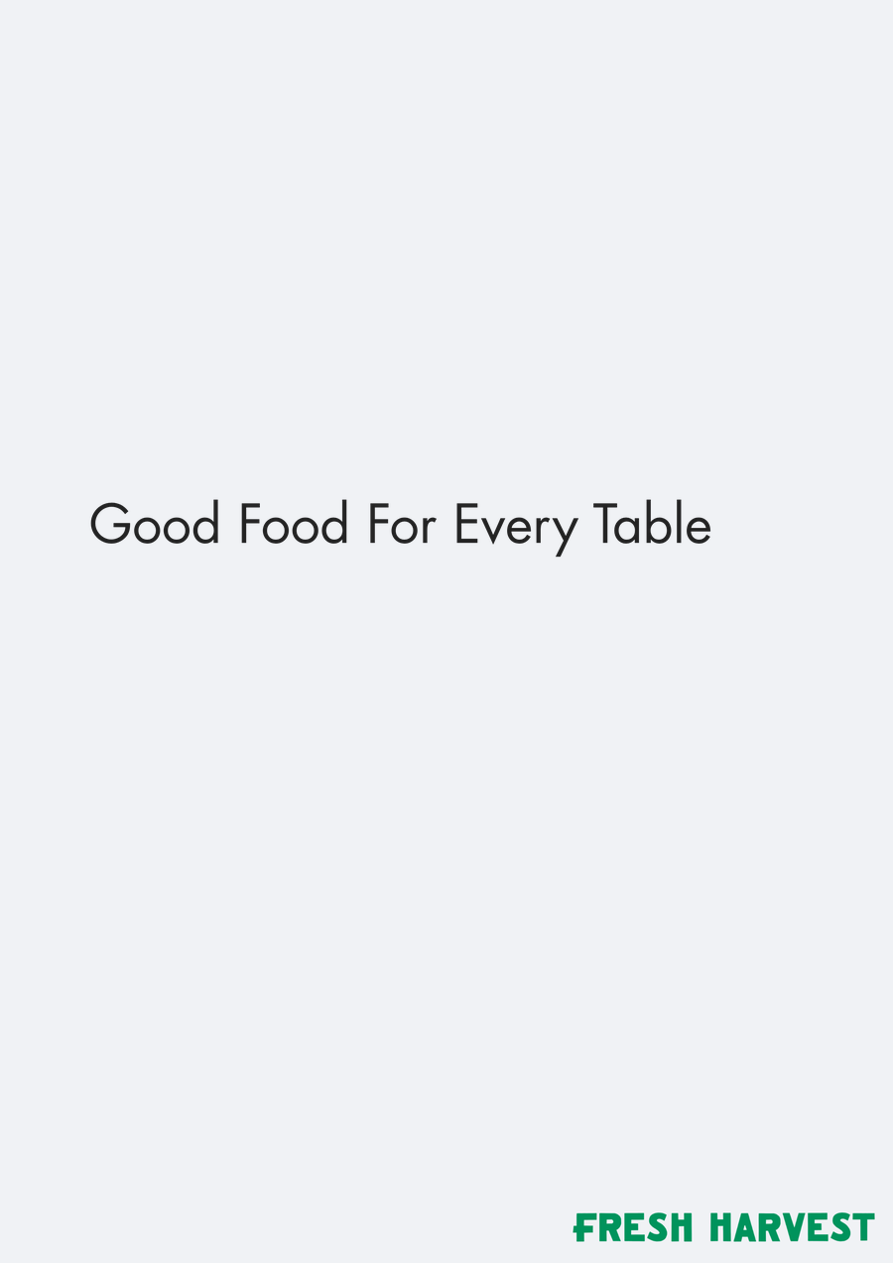


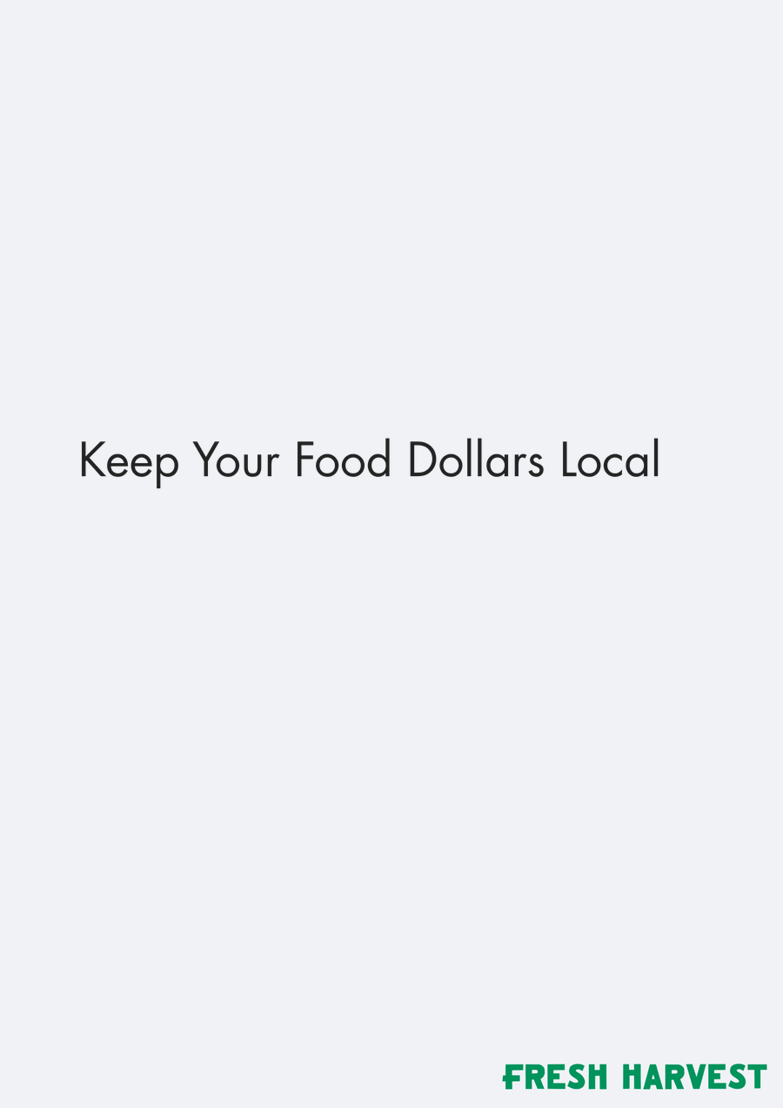
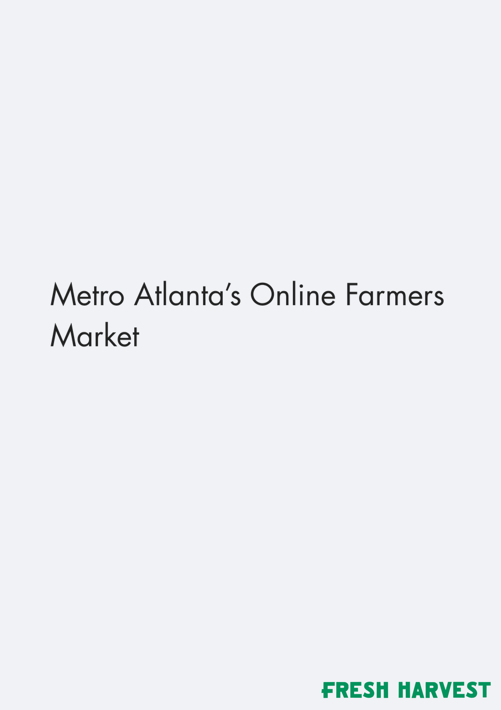
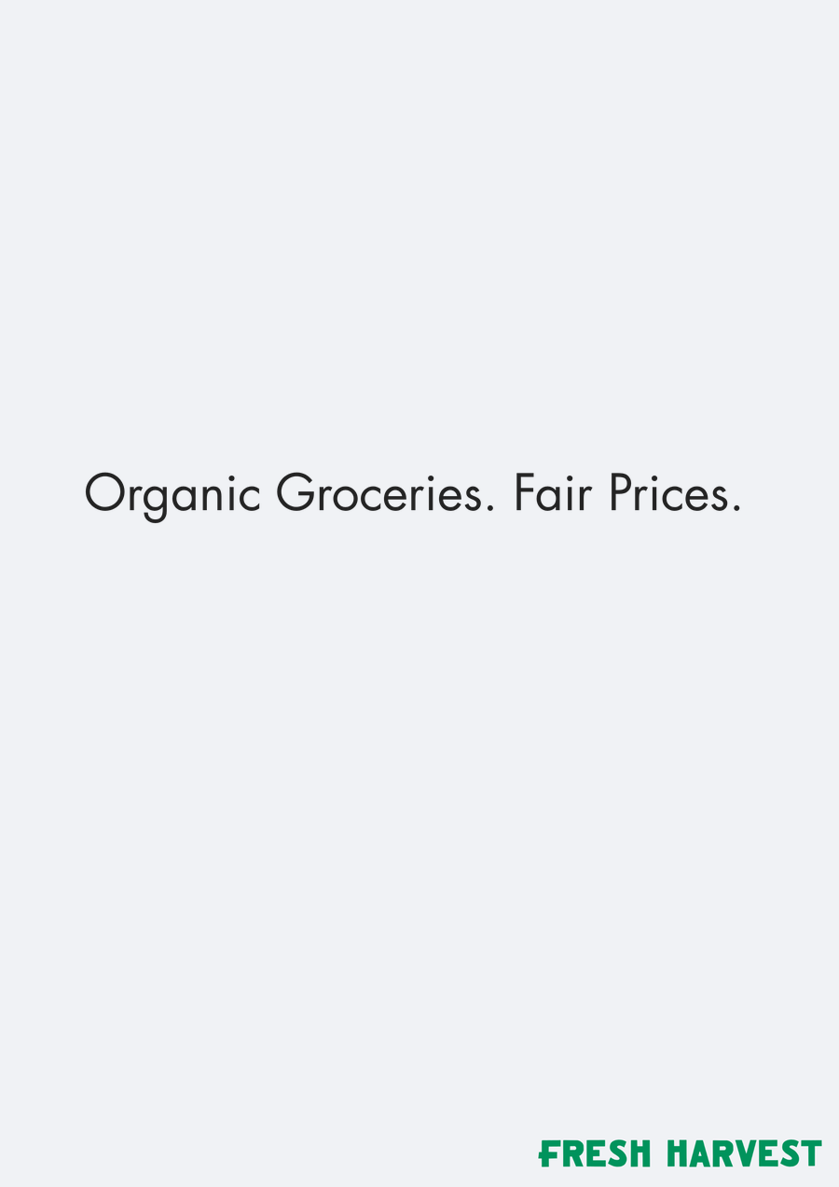
ELEMENT ASSETS
Sub Headers — element assets · 1 of 2
C · 16 variations
Sub Header 80
Sourced Within…
Sub Header Do
You Know Where…
Sub Header Eat
Local Eat…
Sub Header
Georgia Farms…
Sub Header Good
Food For Every…
Sub Header Good
For People And…
Sub Header Guess
The Price Of Our…
Sub Header Keep
Your Food…
Sub Header Metro
Atlanta’s Online…
Sub Header
Organic…
n=312 respondents. Top-2 Box model (ratings 4–5): element lifts show movement above or below the model baseline.
36

Slide 37
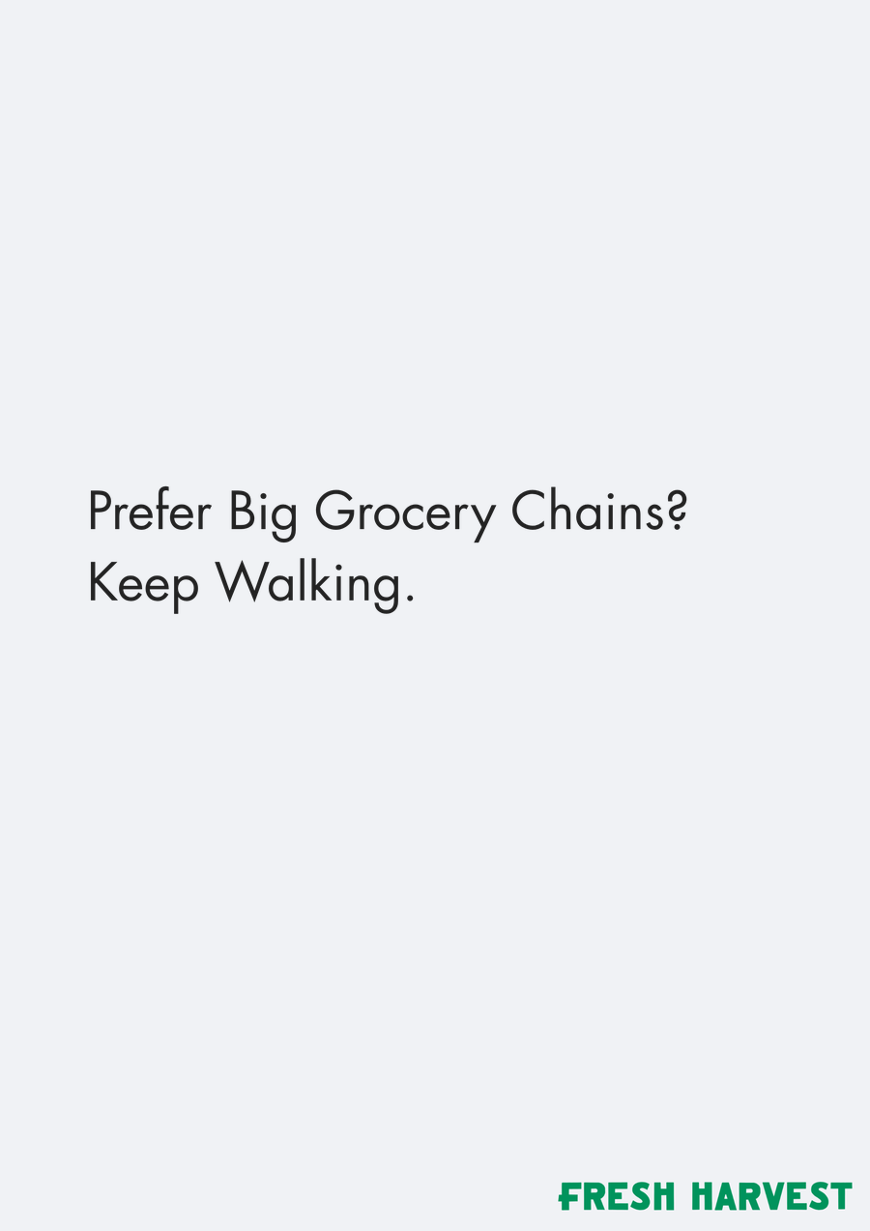
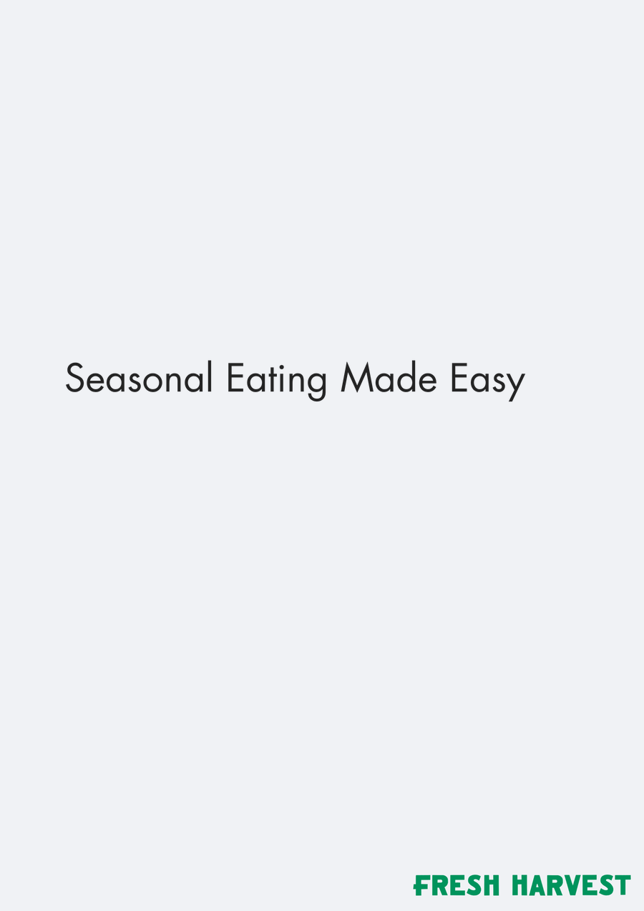

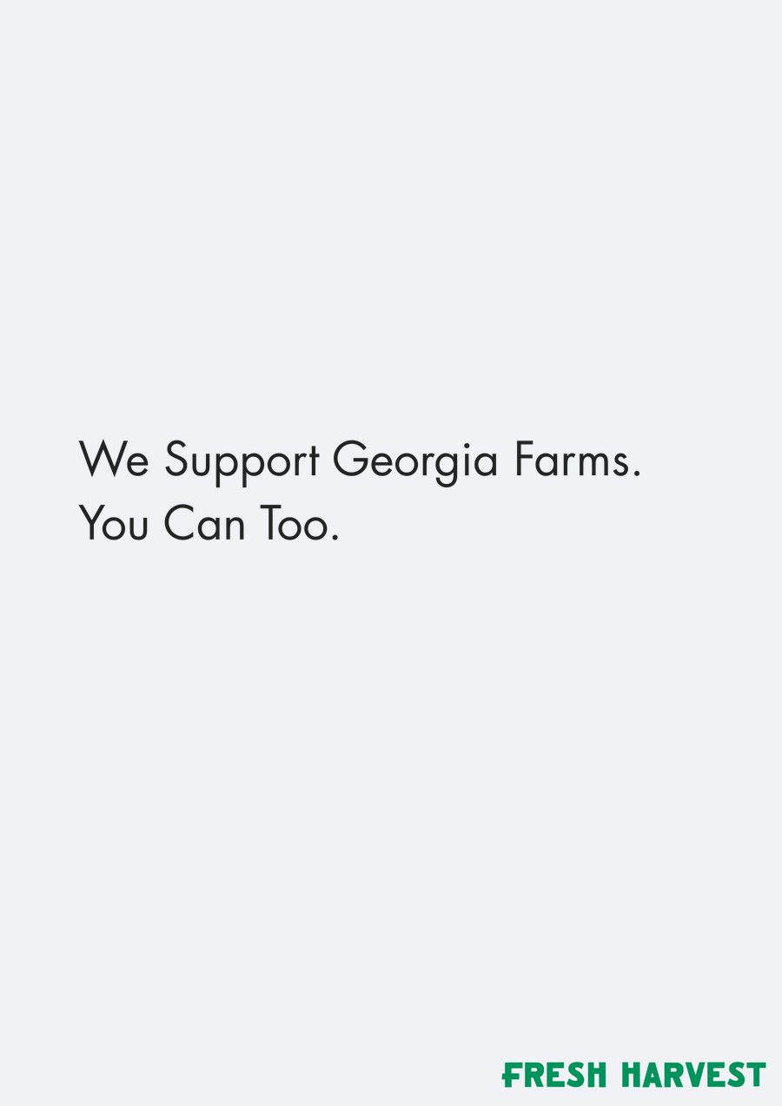


ELEMENT ASSETS
Sub Headers — element assets · 2 of 2
C · 16 variations
Sub Header
Prefer Big…
Sub Header
Seasonal Eating…
Sub Header Skip
The Grocery…
Sub Header We
Support Georgia…
Sub Header Win A
Free Month Of…
Sub Header Visit
Our Booth For 50…
n=312 respondents. Top-2 Box model (ratings 4–5): element lifts show movement above or below the model baseline.
37

Slide 38



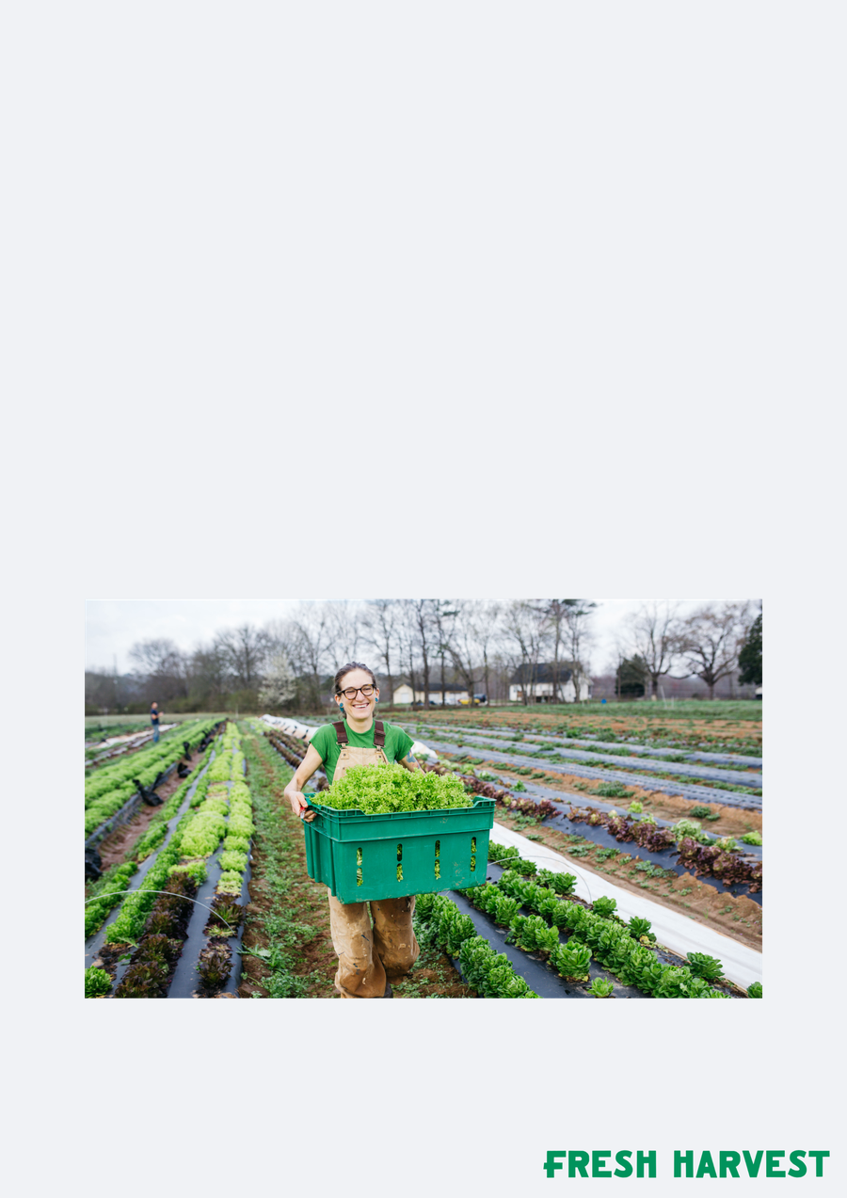



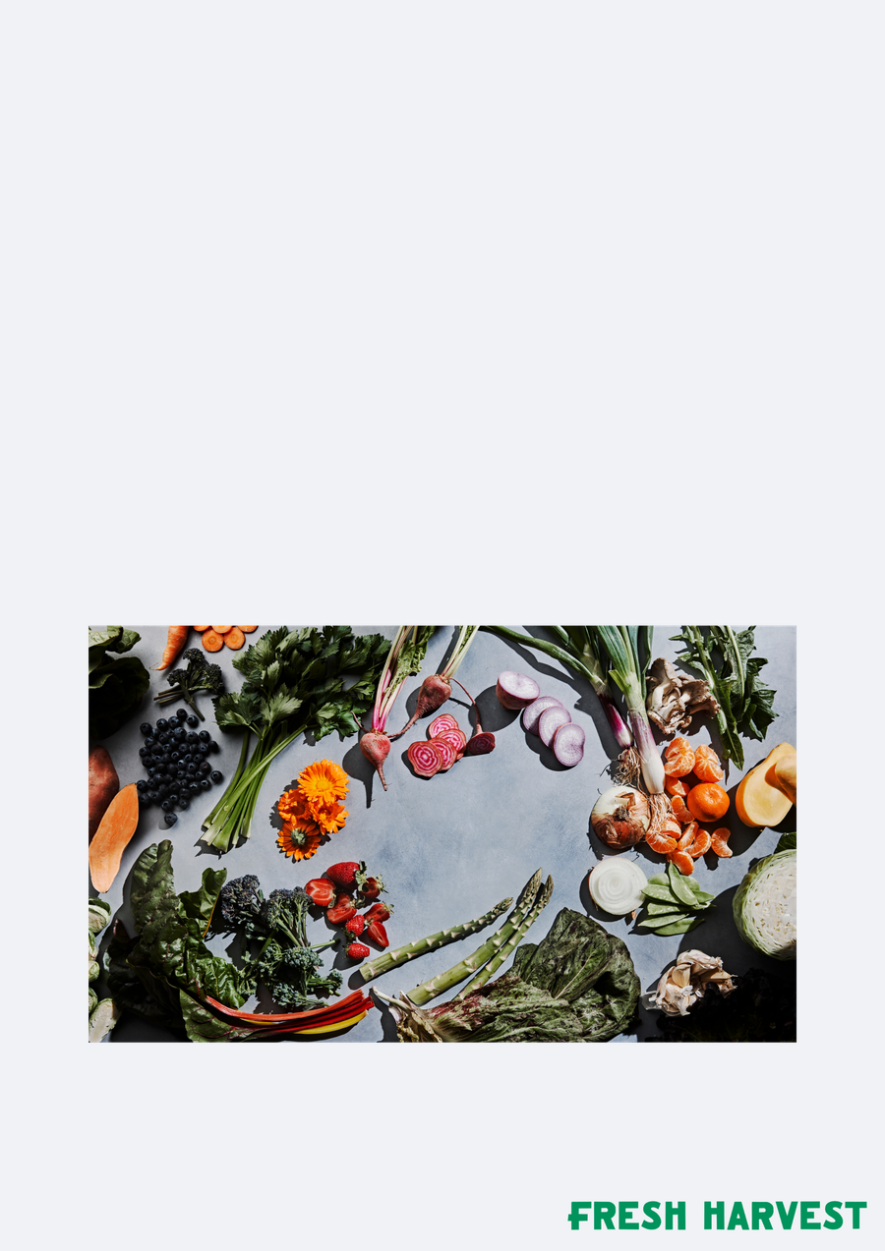
ELEMENT ASSETS
Images — element assets
D · 8 variations
Image Layer Box
Graphic
Image Layer Box
Image Layer
Delivery Graphic
Image Layer Farm
Image Layer
Grocery
Image Layer
Lifestyle
Image Layer Map
Graphic
Image Layer
Produce
n=312 respondents. Top-2 Box model (ratings 4–5): element lifts show movement above or below the model baseline.
38

Slide 39
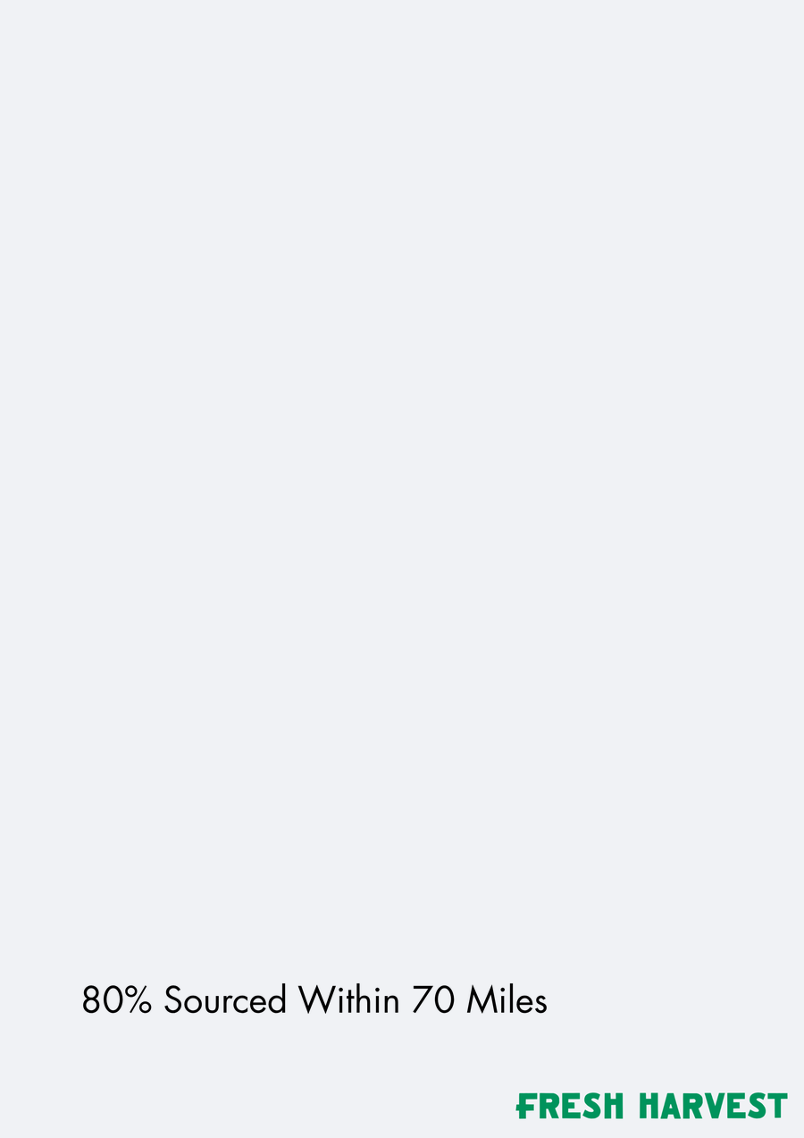


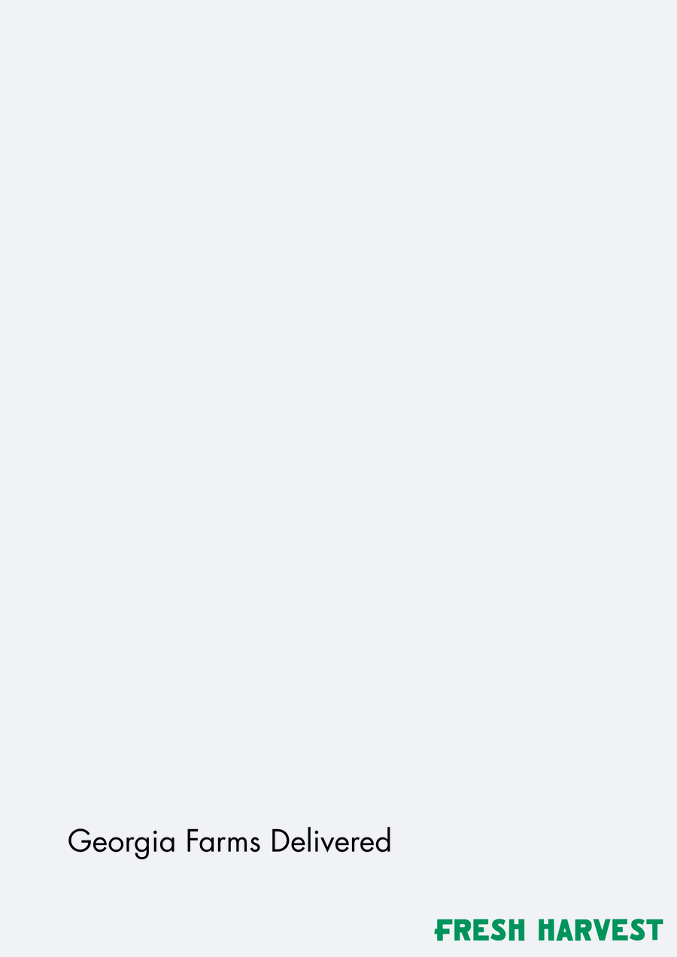






ELEMENT ASSETS
CTA — element assets · 1 of 2
E · 16 variations
Cta 80 Sourced
Within 70 Miles
Cta Do You Know
Where Your Food…
Cta Eat Local
Eat Organic Eat…
Cta Georgia
Farms Delivered
Cta Good Food
For Every Table
Cta Good For
People And The…
Cta Guess The
Price Of Our Box…
Cta Keep Your
Food Dollars…
Cta Metro
Atlanta’s Online…
Cta Organic
Groceries Fair…
n=312 respondents. Top-2 Box model (ratings 4–5): element lifts show movement above or below the model baseline.
39

Slide 40
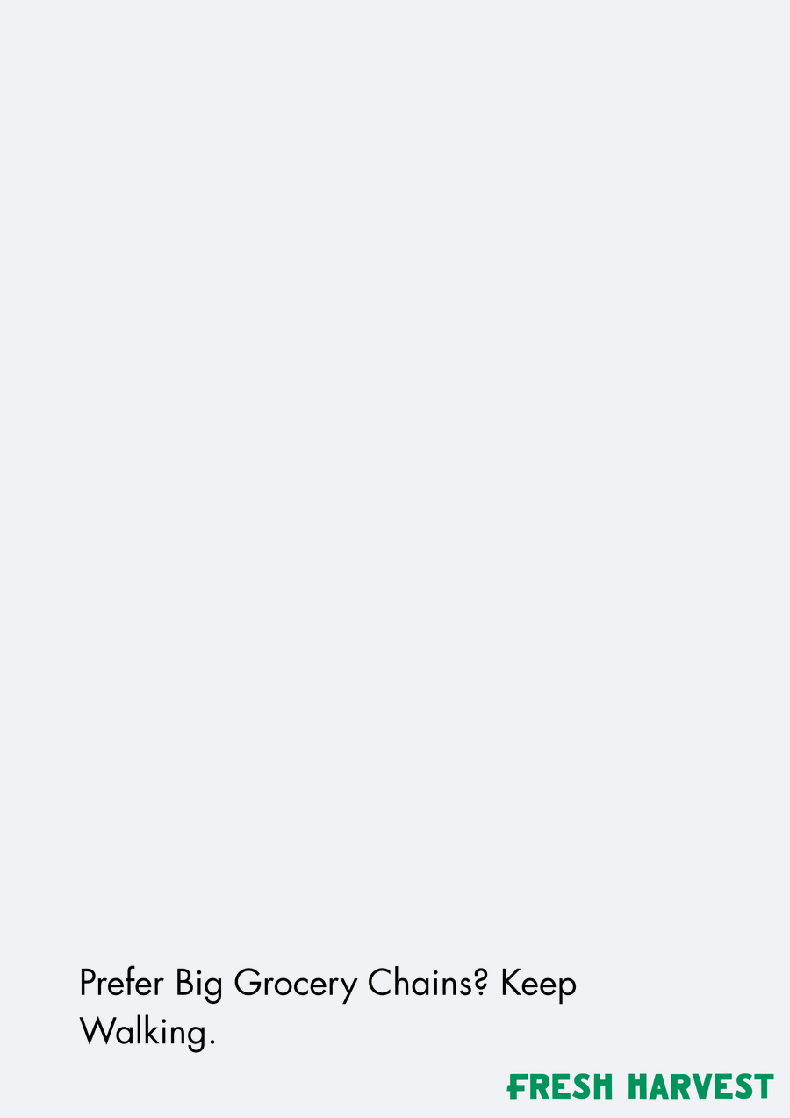
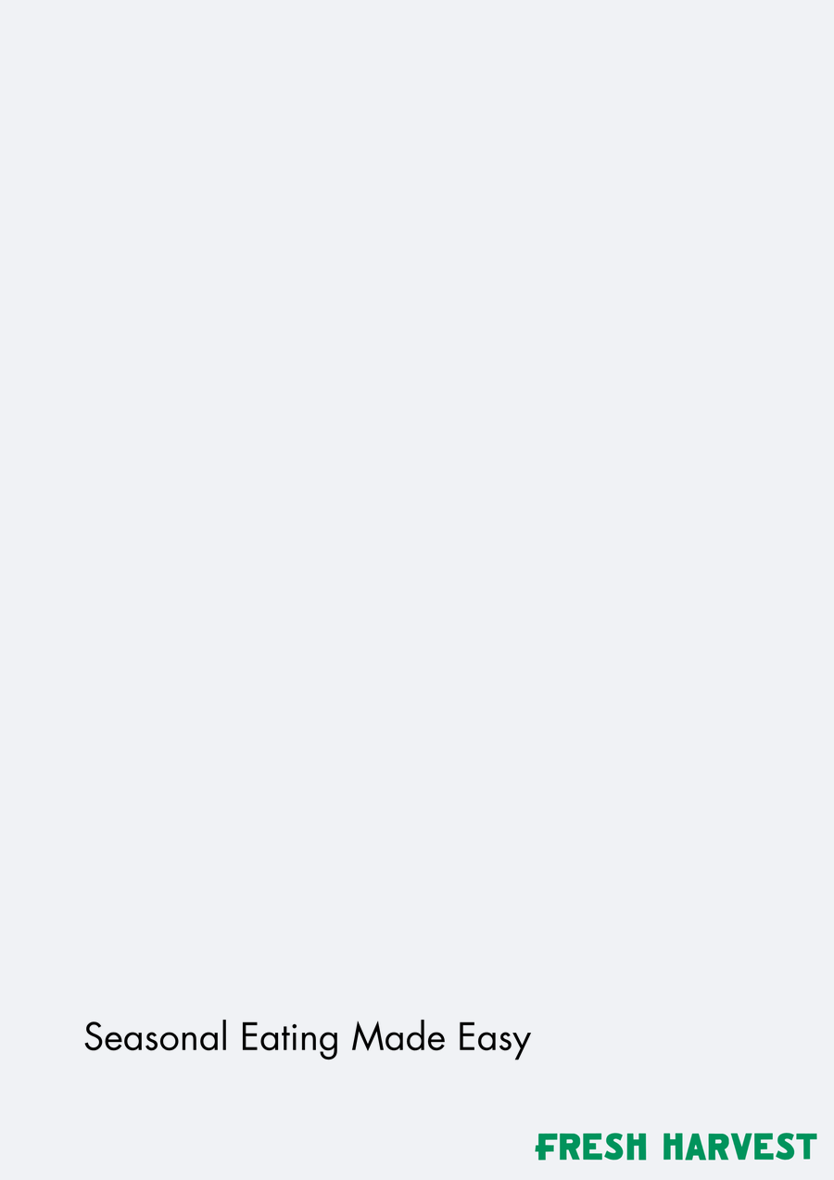




ELEMENT ASSETS
CTA — element assets · 2 of 2
E · 16 variations
Cta Prefer Big
Grocery Chains…
Cta Seasonal
Eating Made Easy
Cta Skip The
Grocery Store
Cta Visit Our
Booth For 50 Off
Cta We Support
Georgia Farms…
Cta Win A Free
Month Of…
n=312 respondents. Top-2 Box model (ratings 4–5): element lifts show movement above or below the model baseline.
40

Slide 41
Thank you
We look forward to discussing the full report and next steps.
A-FRAME SIGN STUDY Appeal Report | August 2026
Prepared by: J Brown Fitterman | jbrown@mindgenomicsassociates.com
Mind Genomics Associates, Inc
A-FRAME SIGN STUDY

